Slide 1
Embedded Systems
Introduction to Xilinx Vivado and ZYBO
César Monteiro , Nelson Naia, Joao Gonçalves, Diogo Lima, Diogo Lima, Ricardo Teixeira

Slide 2
Agenda
Create an RTL Project in Xilinx Vivado
Program the ZYBO board
Instantiate an IP-core in a Project

Slide 3
Fazer download : https://github.com/Digilent/vivado-boards/archive/master.zip
Copy the contents of the board_files folder
Navigate to the board_files folder in the Vivado Installation directory (C:\Xilinx\Vivado\2018.1\data\boards\board_files)
Paste the contents into the board_files folder

Slide 4
Create an RTL Project in Xilinx Vivado

Slide 5
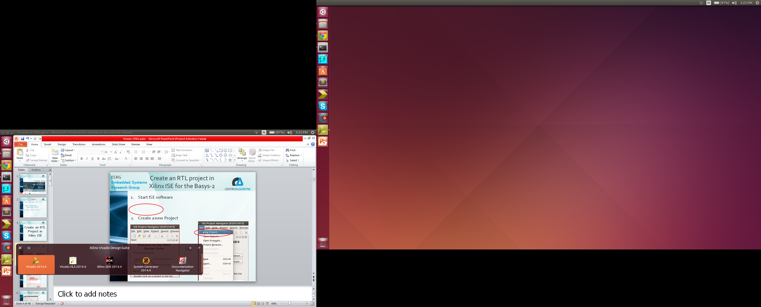
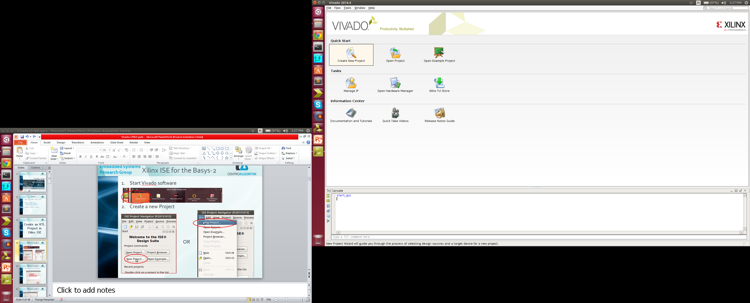
Create an RTL Project in Xilinx Vivado for ZYBO
Start Vivado software
Create a new Project

Slide 6
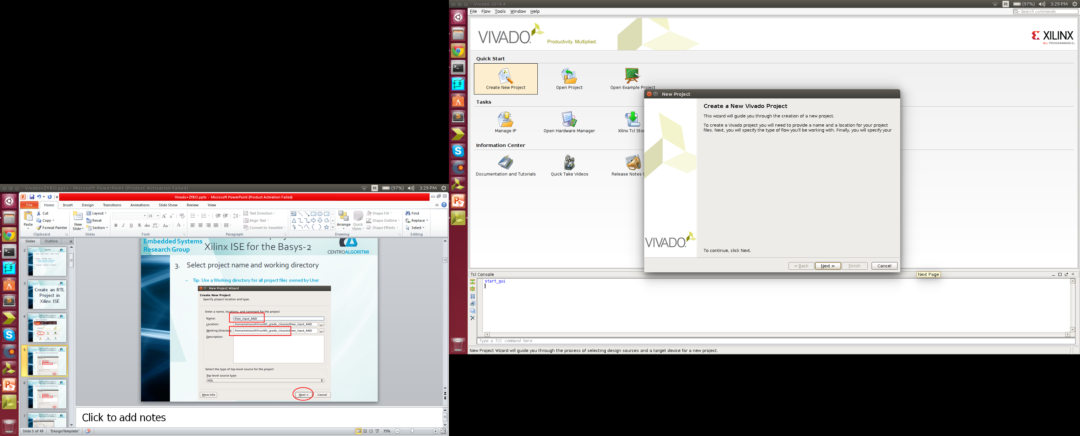
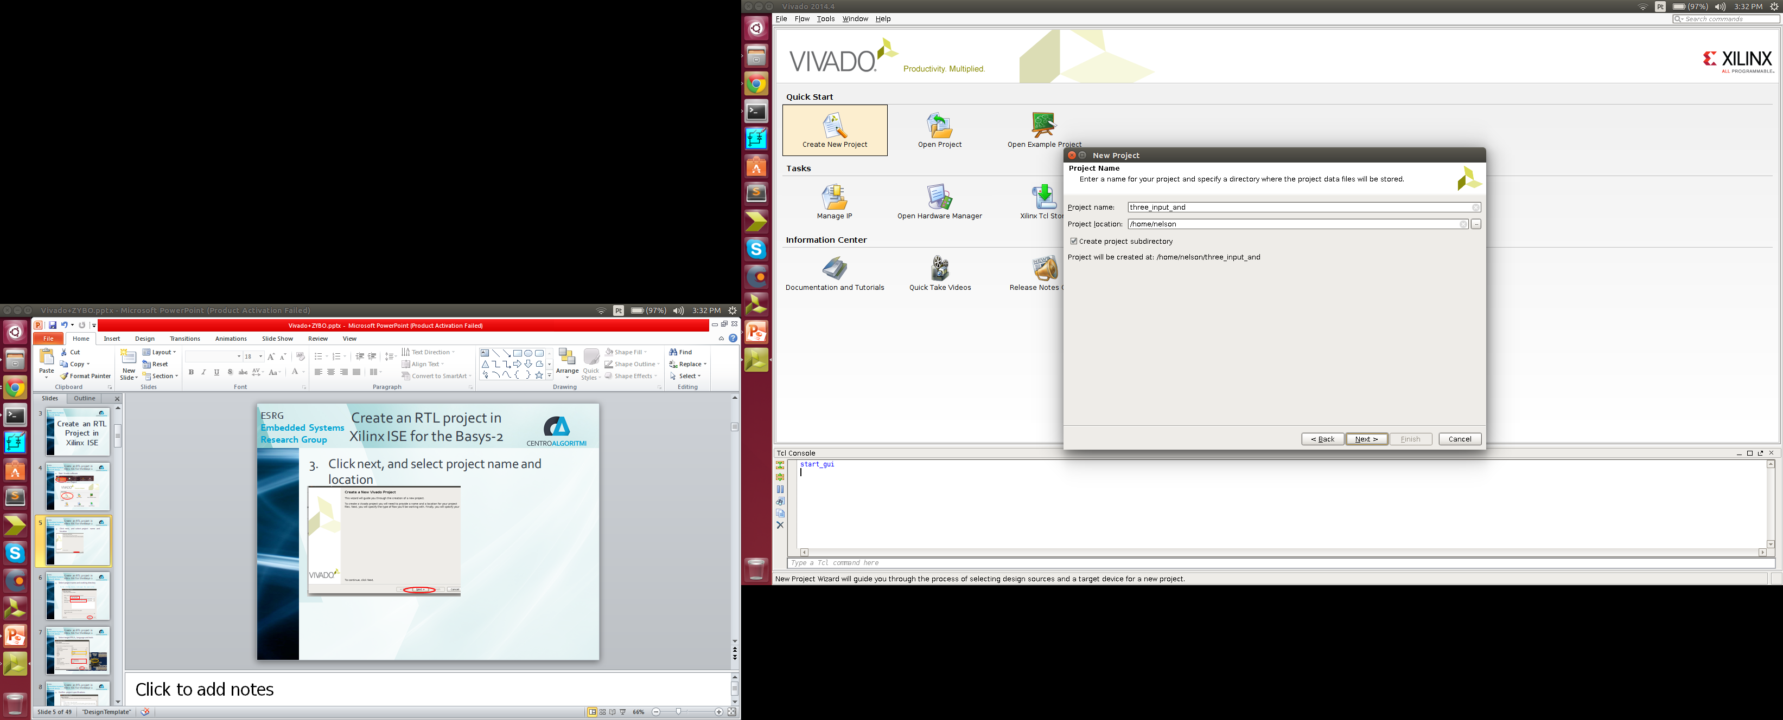
Create an RTL Project in Xilinx Vivado for ZYBO
Click next, and select project name and location

Slide 7

Create an RTL Project in Xilinx Vivado for ZYBO
Select RTL Project Type

Slide 8
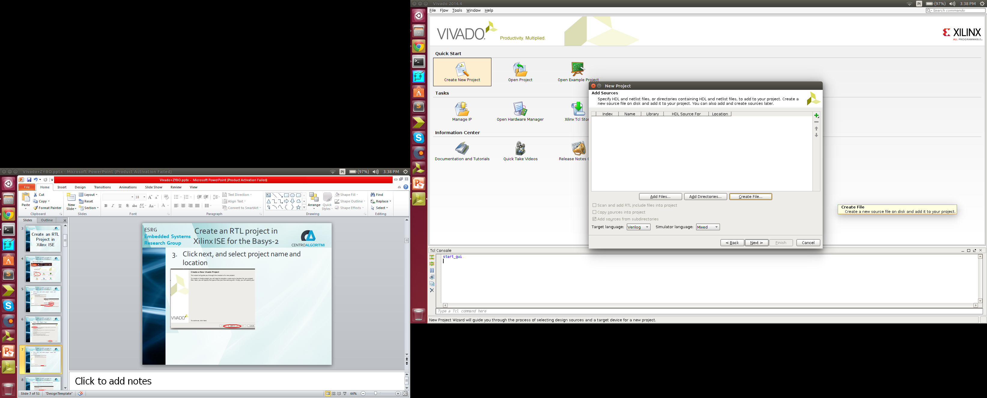
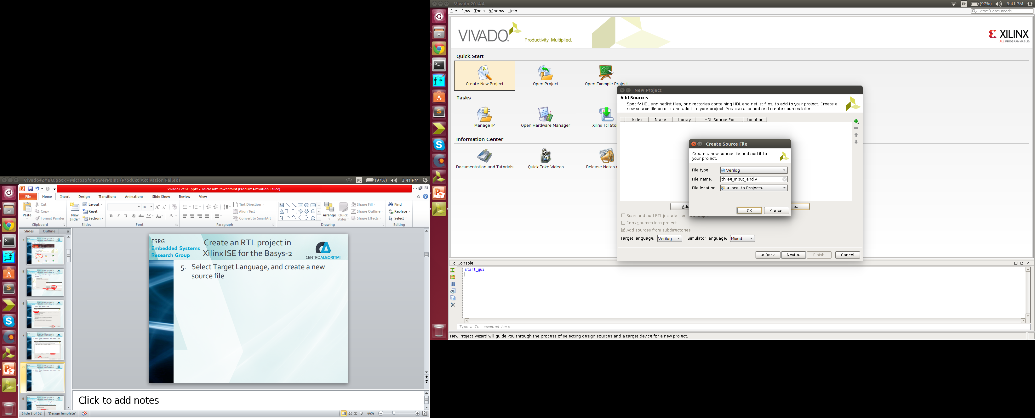
Create an RTL Project in Xilinx Vivado for ZYBO
Select Target Language, and create a new source file

Slide 9

Create an RTL Project in Xilinx Vivado for ZYBO
Skip the IP addition step

Slide 10
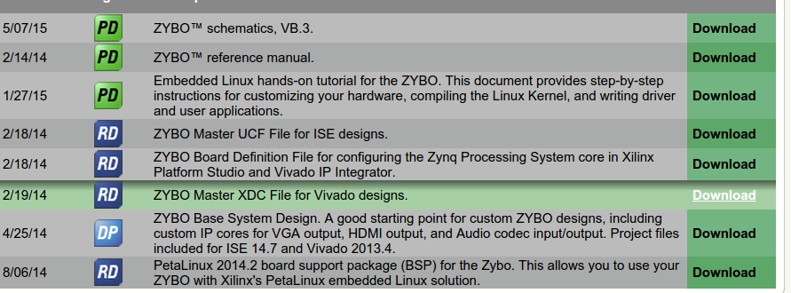
Create an RTL Project in Xilinx Vivado for ZYBO
Download Master XDC File from Digilent’s website: Digilent ZYBO page

Slide 11
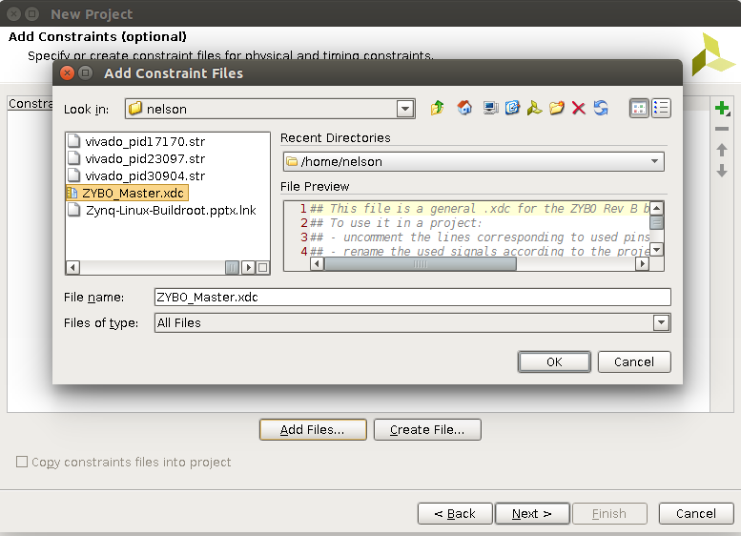
Create an RTL Project in Xilinx Vivado for ZYBO
Add the downloaded XDC file in the constraints addition step
XDC files are similar to the UCF files for ISE
It is used to map inputs and outputs as, like ISE, as well as other physical and design constraints

Slide 12
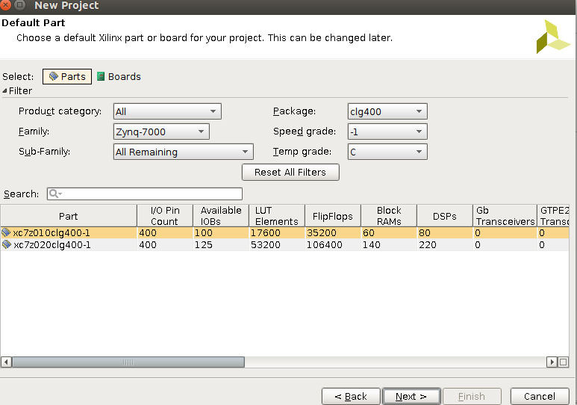
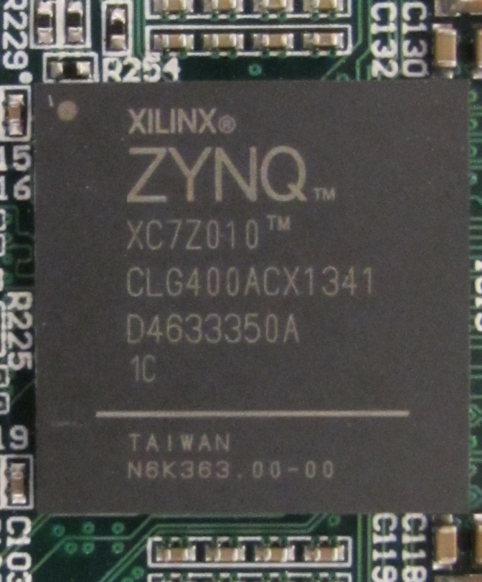
Create an RTL Project in Xilinx Vivado for ZYBO
Select target device
Vivado doesn’t have board support for ZYBO
The Chip must be selected from parts

Slide 13
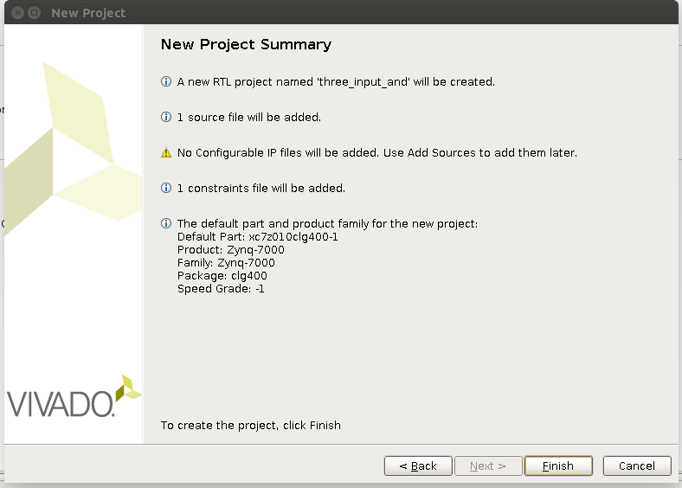
Create an RTL Project in Xilinx Vivado for ZYBO
Confirm project details

Slide 14
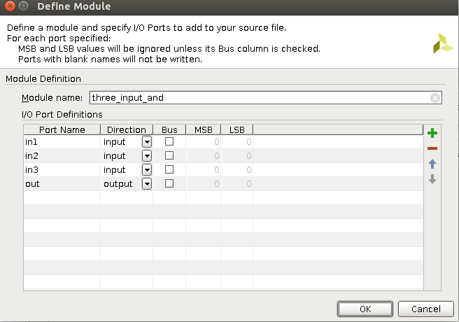
Create an RTL Project in Xilinx Vivado for ZYBO
Create the module via wizard, like ISE

Slide 15
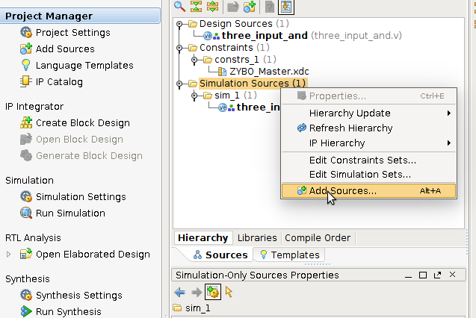
Create an RTL Project in Xilinx Vivado for ZYBO
You may view your source files in the sources tab, under Hierarchy subtab, as well as manually adding more sources, constraints, or any kind of files

Slide 16
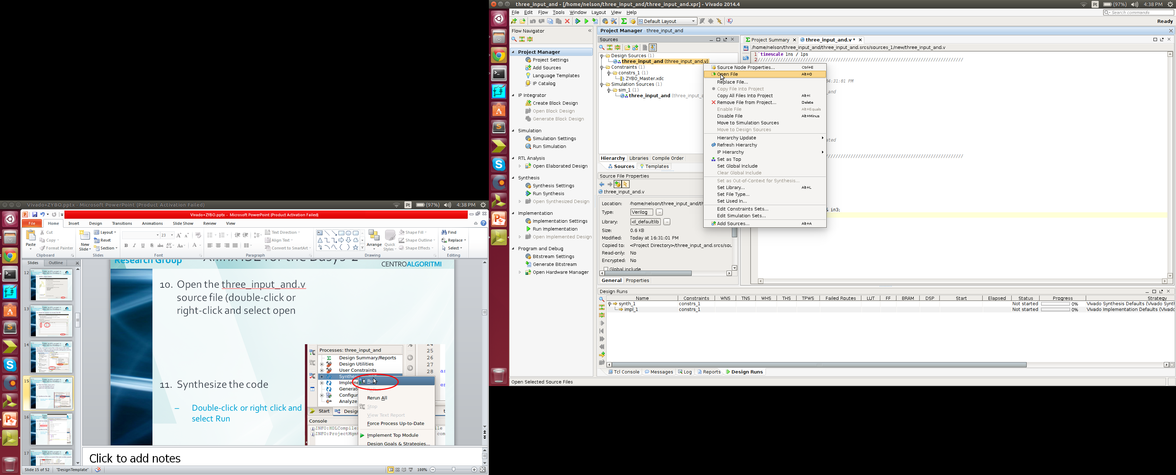
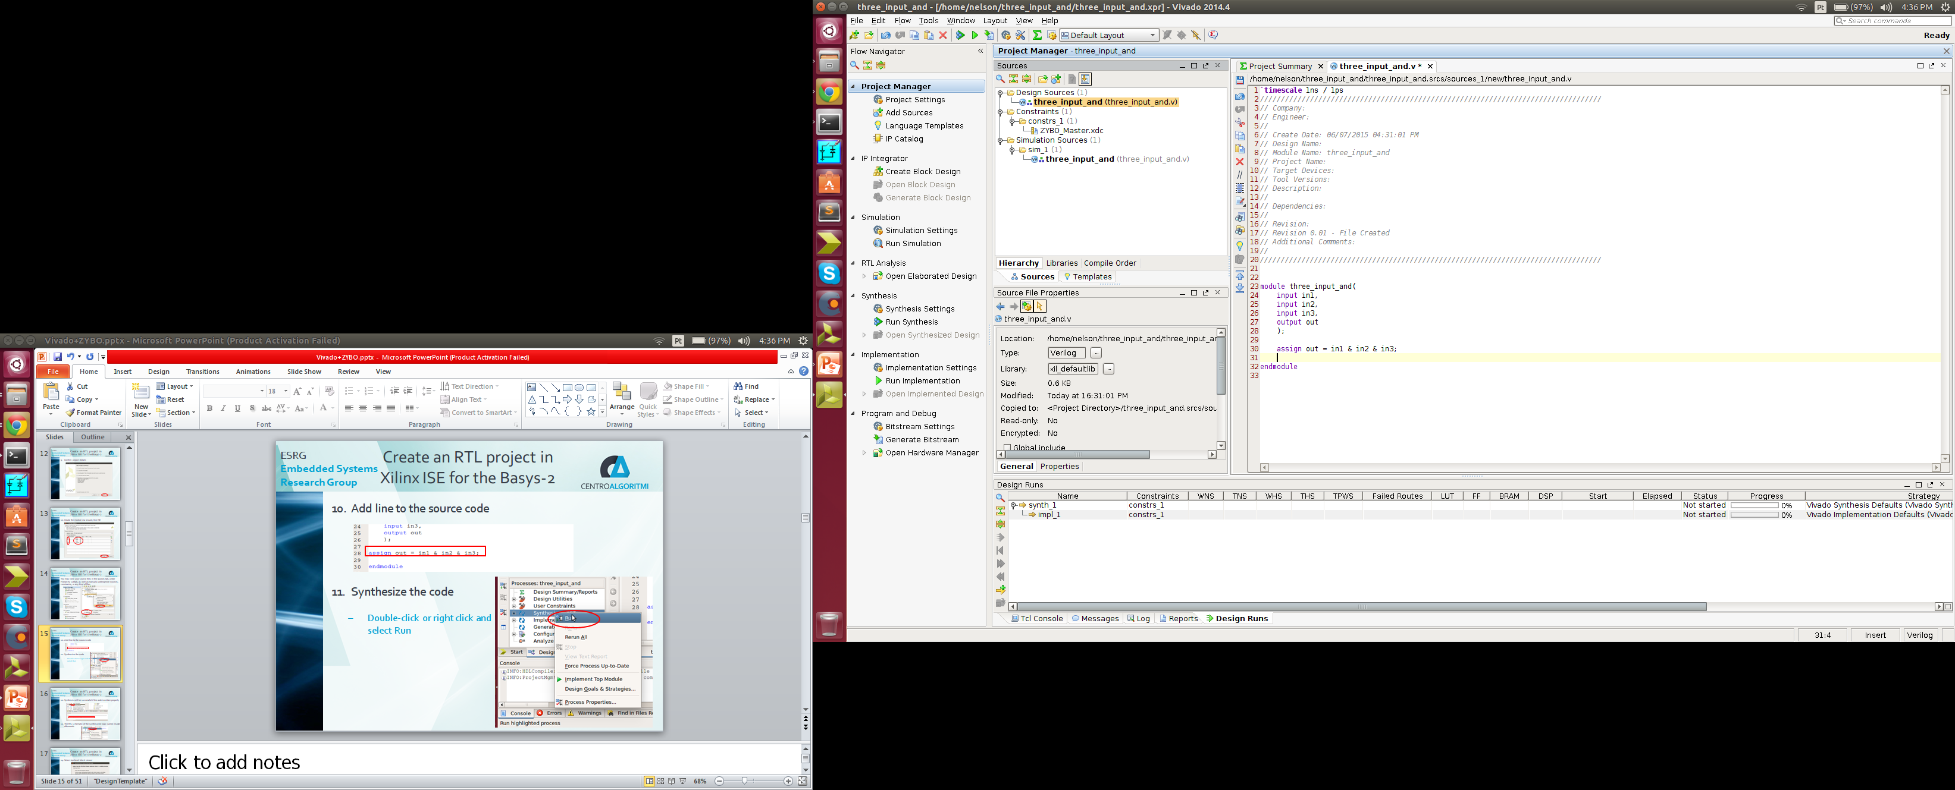
Create an RTL Project in Xilinx Vivado for ZYBO
Open the three_input_and.v source file
(double-click or right-click and select open
Add the line to the source code, and save file changes

Slide 17


Create an RTL Project in Xilinx Vivado for ZYBO
View the RTL schematic by clicking Open Elaborated Design

Slide 18

Create an RTL Project in Xilinx Vivado for ZYBO
Run synthesis

Slide 19
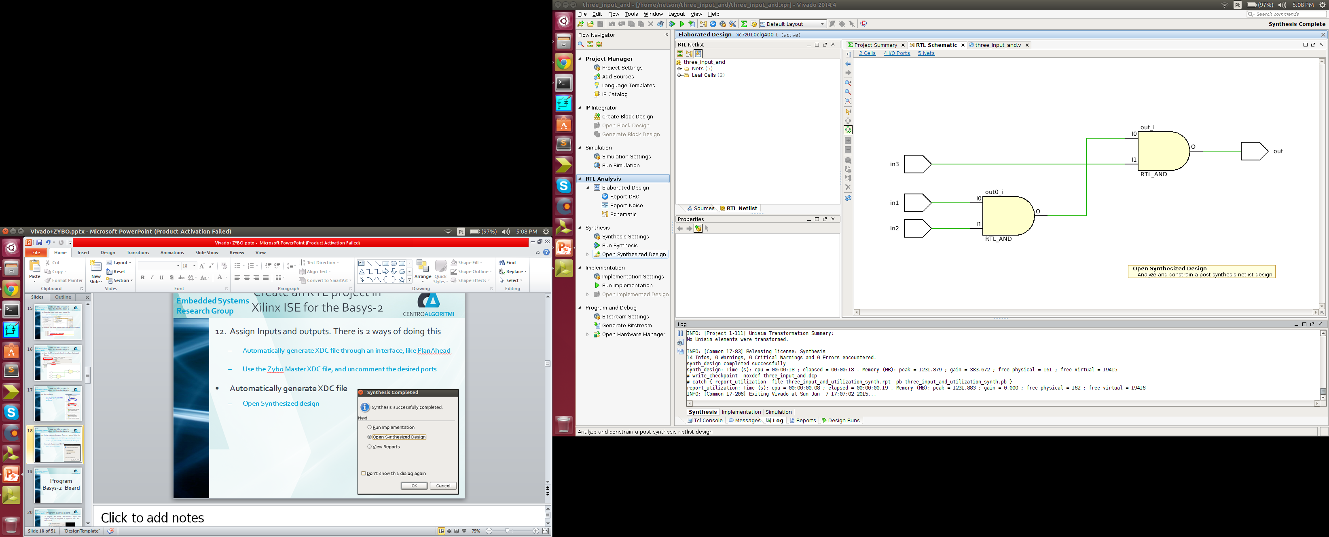
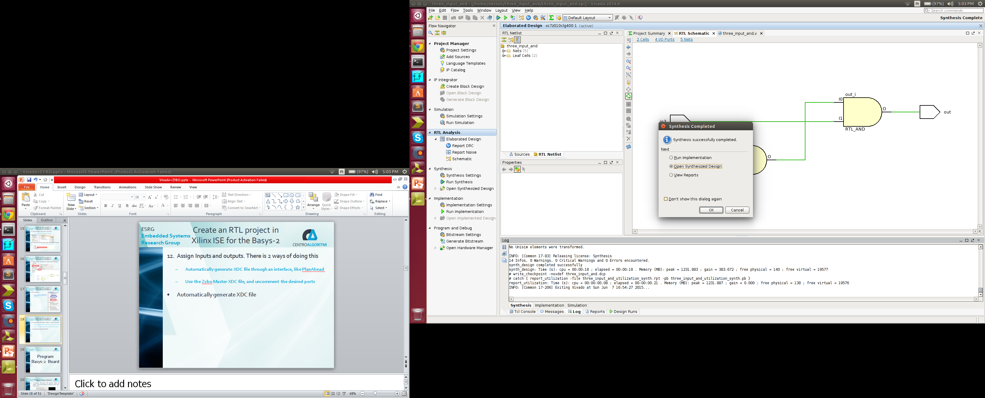
Create an RTL Project in Xilinx Vivado for ZYBO
Open Synthesized Design
OR

Slide 20
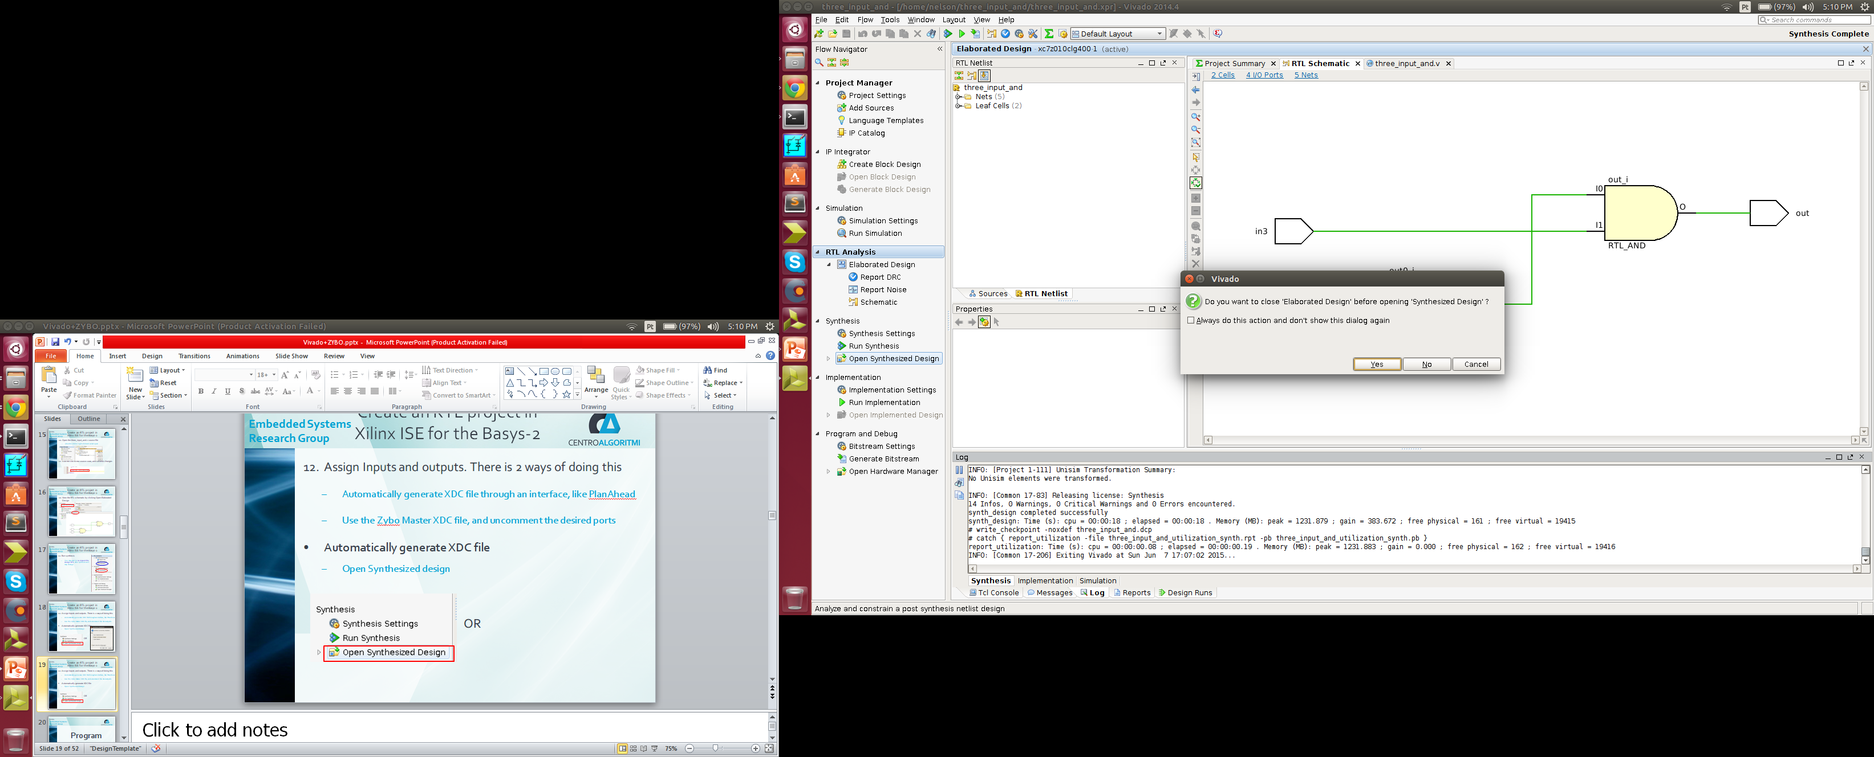
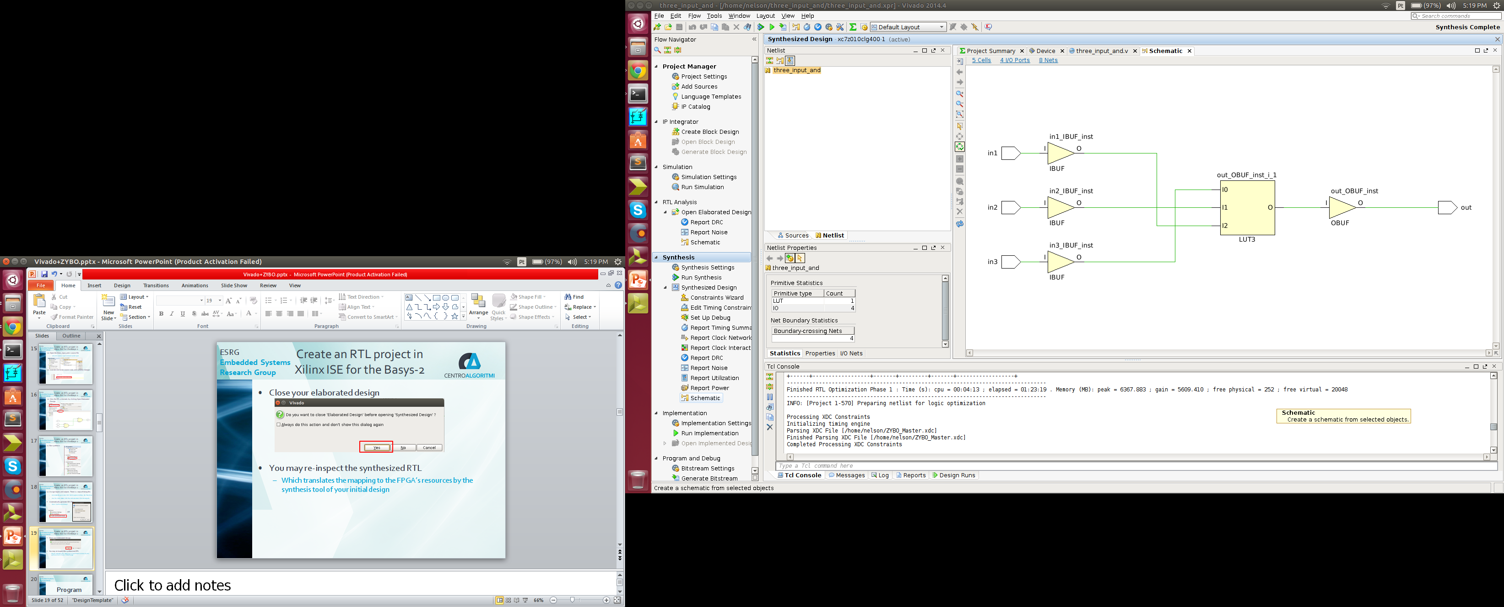
Create an RTL Project in Xilinx Vivado for ZYBO
Close your elaborated design
You may re-inspect the synthesized RTL
Which translates the mapping to the FPGA’s resources by the synthesis tool of your initial design

Slide 21
Program ZYBO PL

Slide 22
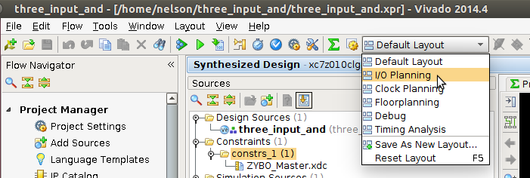
Program ZYBO PL
Assign Inputs and outputs. There is 2 ways of doing this
Automatically generate XDC file through an interface, like PlanAhead
Use the ZYBO Master XDC file, and uncomment the desired ports
Automatically generate XDC file:
Select I/O Planning Layout with the Synthesized Design opened

Slide 23
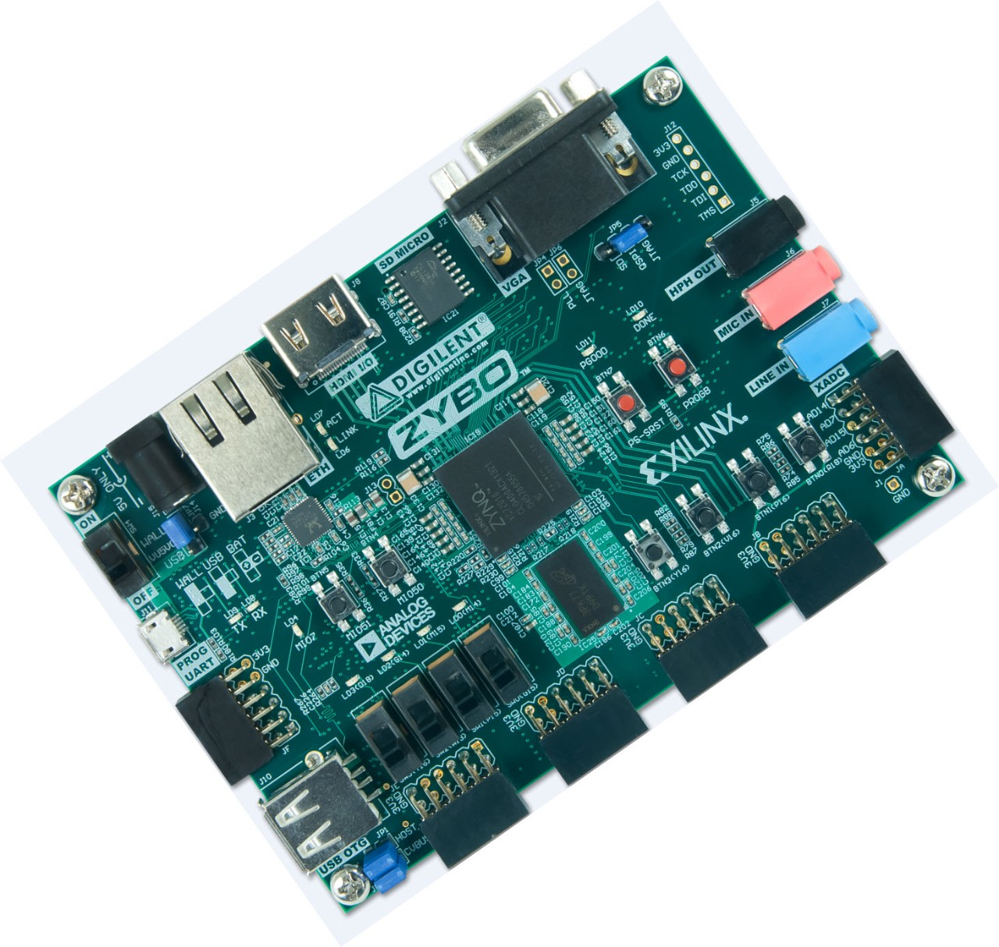
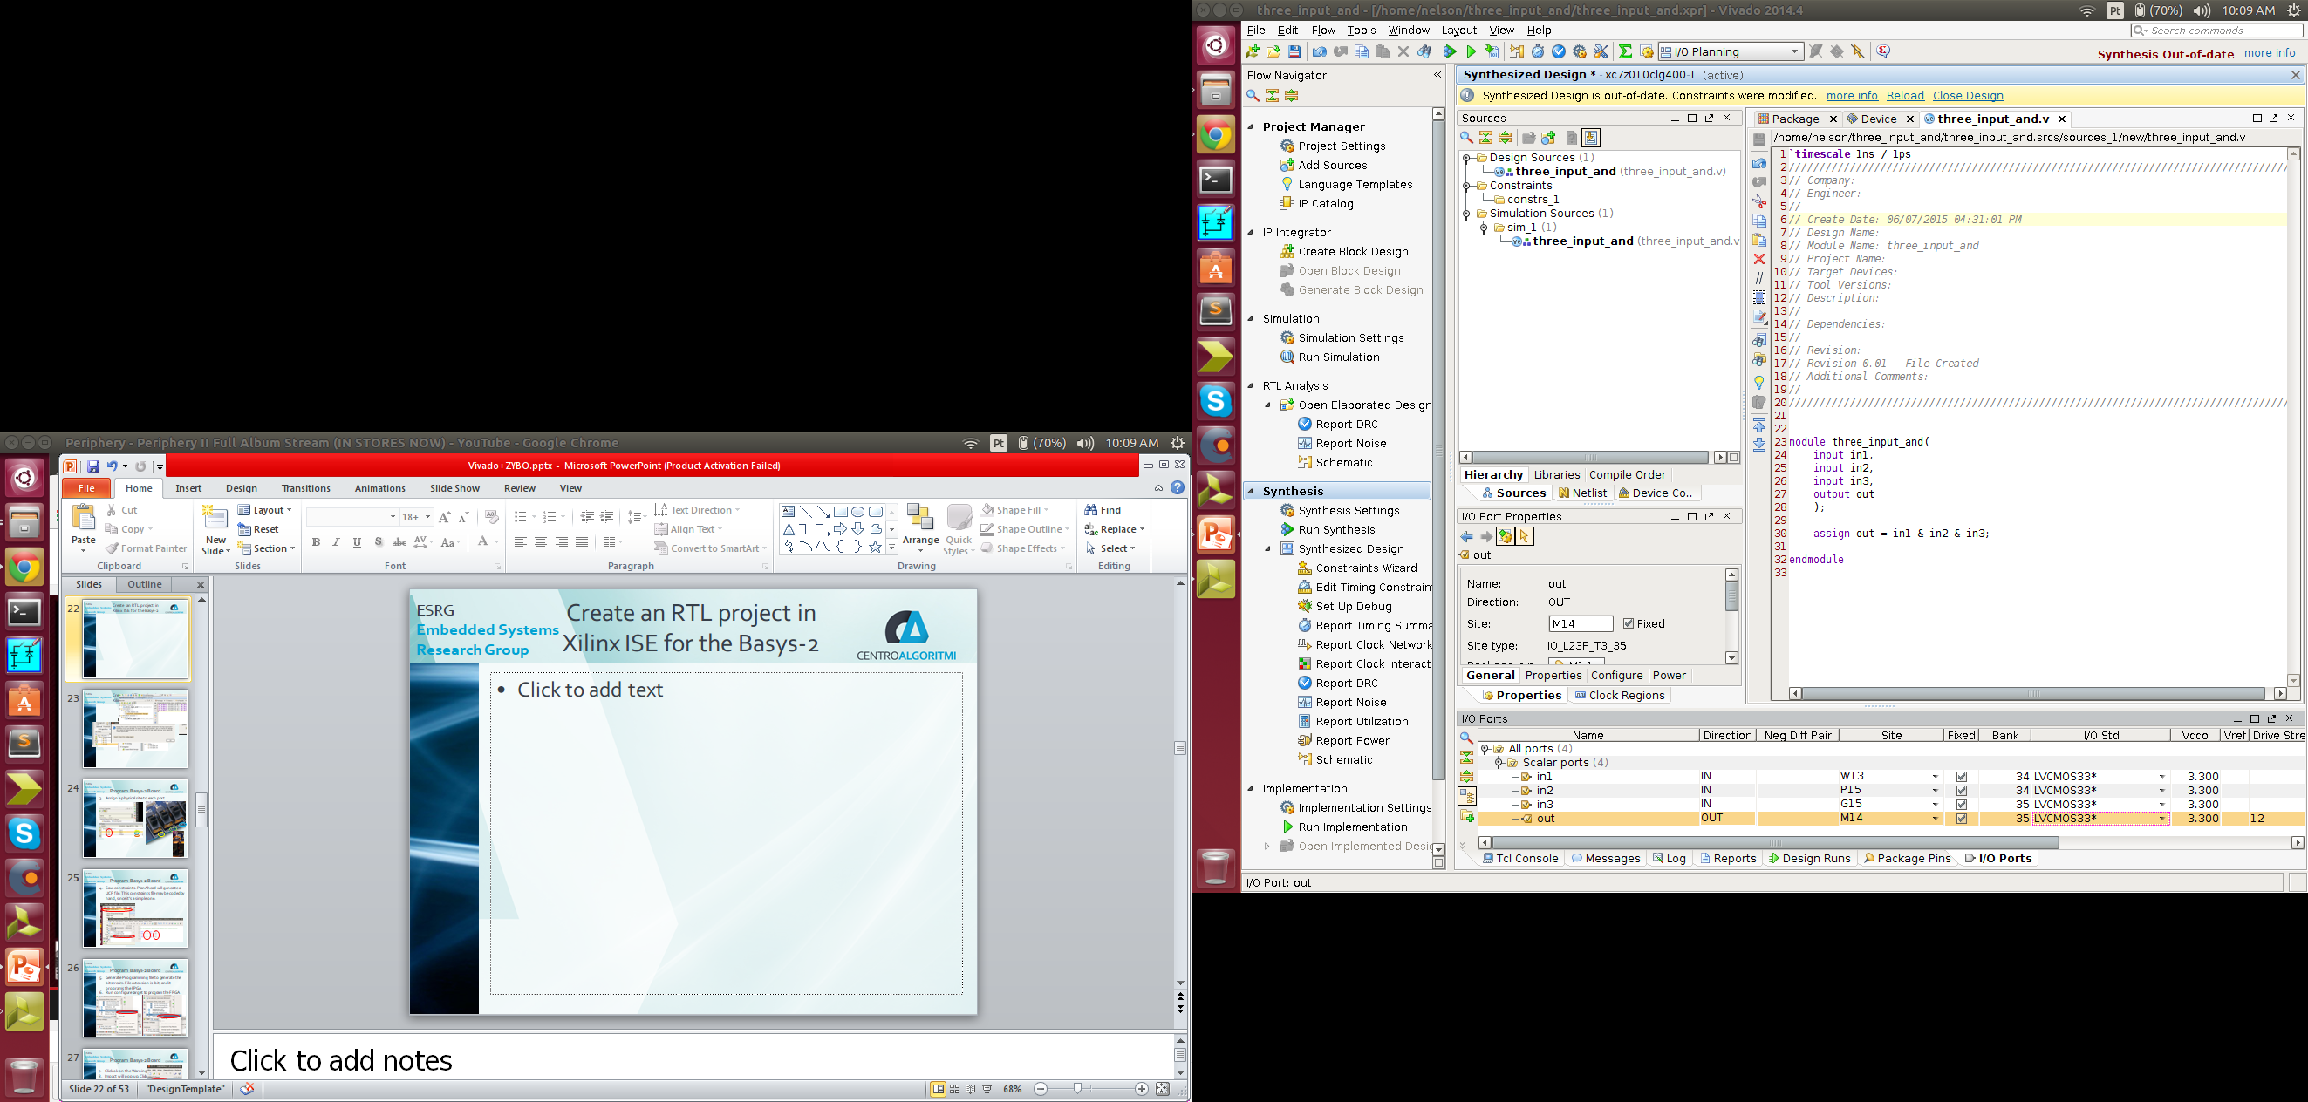
Program ZYBO PL
In case it went by unnoticed, the interface is similar to PlanAhead
Also set LVCMOS33 for 3.3V

Slide 24
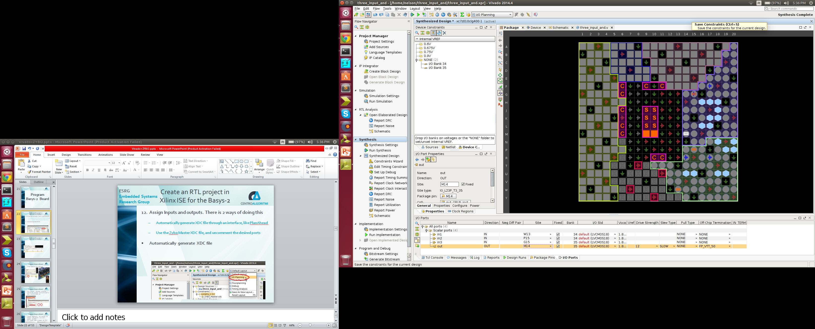
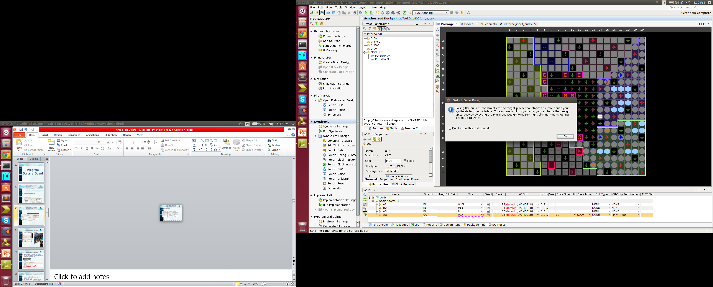
Program ZYBO PL
Click the save icon, and afterwards, click ok

Slide 25
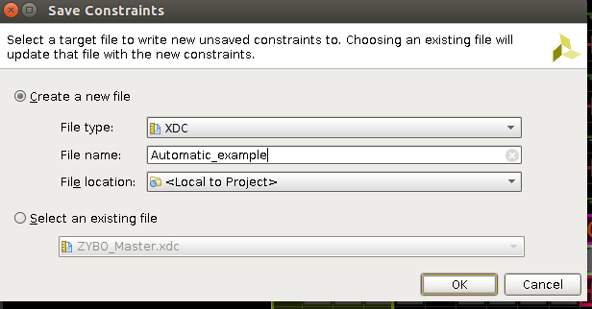
Program ZYBO PL
Select create a new file, and name the XDC file

Slide 26
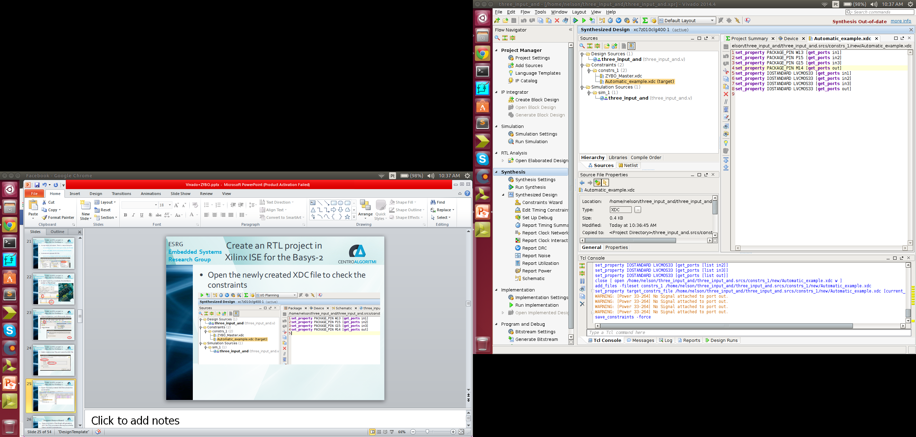
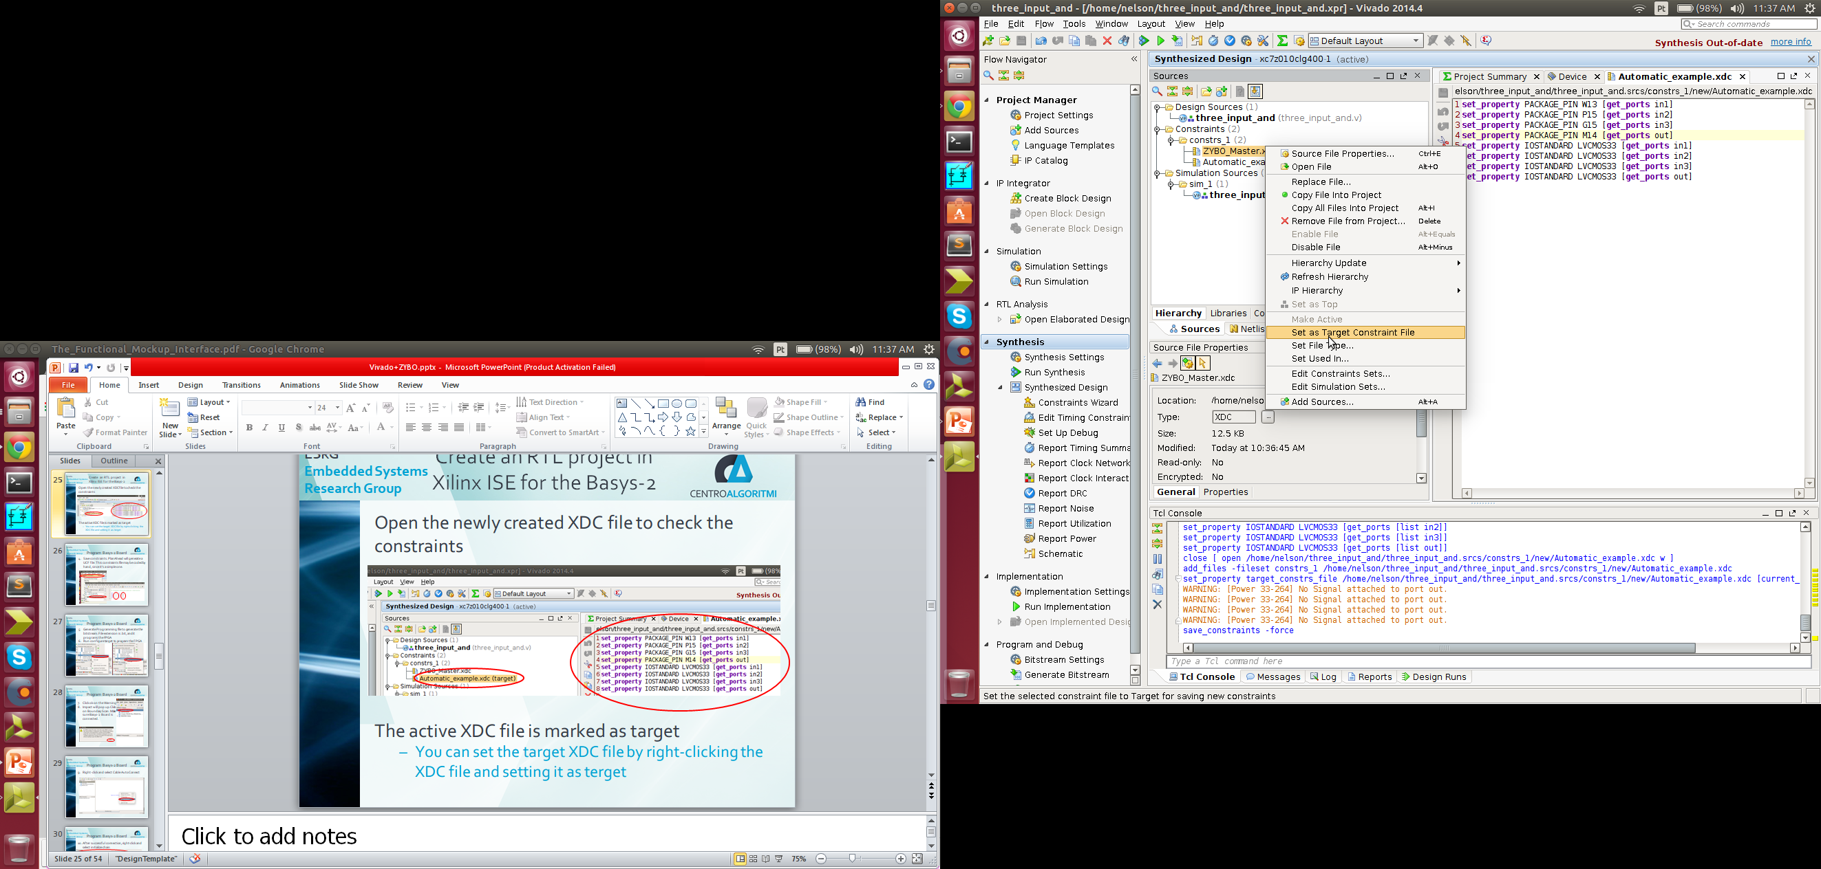
Program ZYBO PL
Open the newly created XDC file to check the constraints
The active XDC file is marked as target
You can set the target XDC file by right-clicking the XDC file and setting it as target

Slide 27
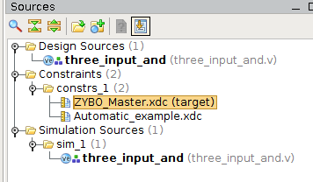
Program ZYBO PL
Alternative: Use the ZYBO Master XDC file
Set the ZYBO Master XDC file as target

Slide 28
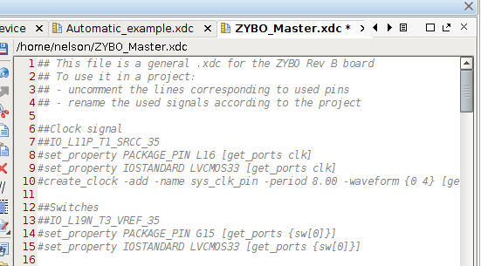
Program ZYBO PL
This file has all physical constraints for the board connections commented
## is a true comment
# is a constraint that may be uncommented

Slide 29
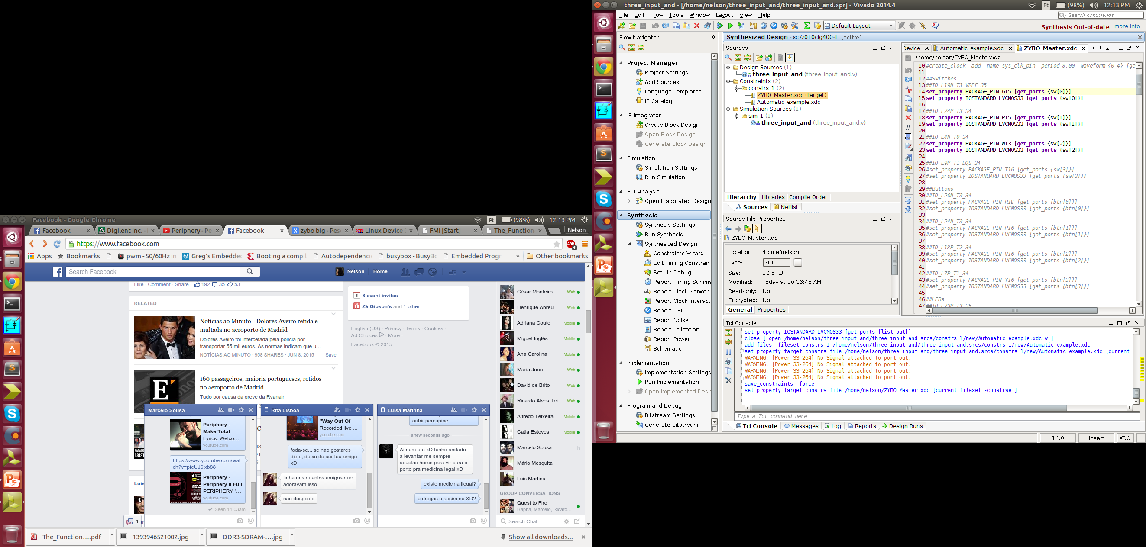
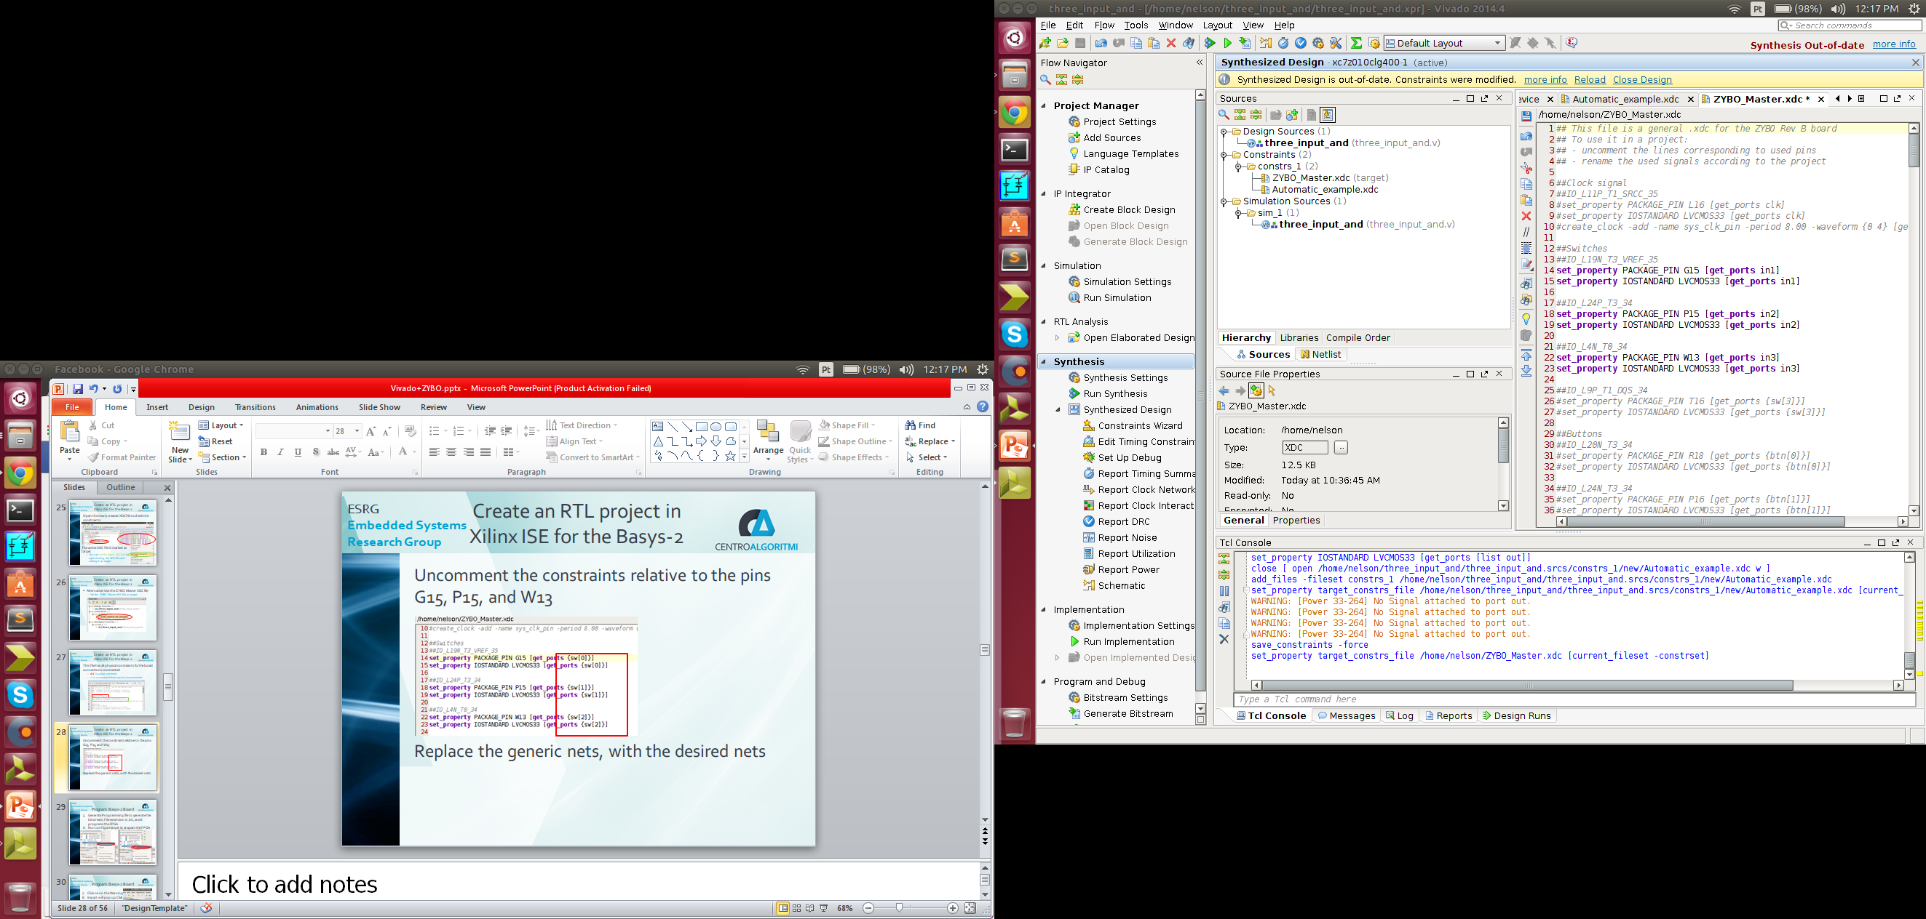
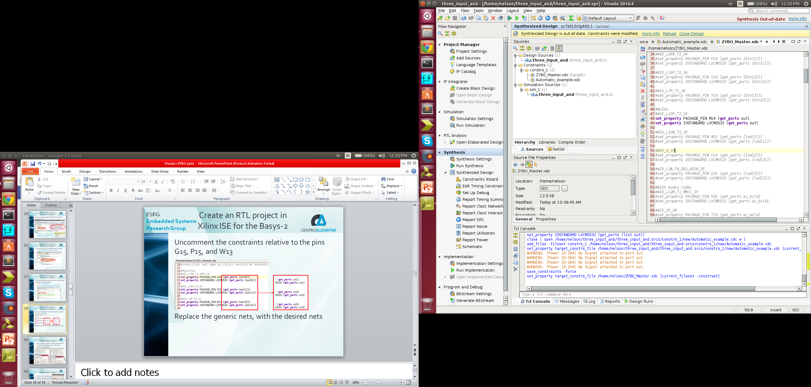
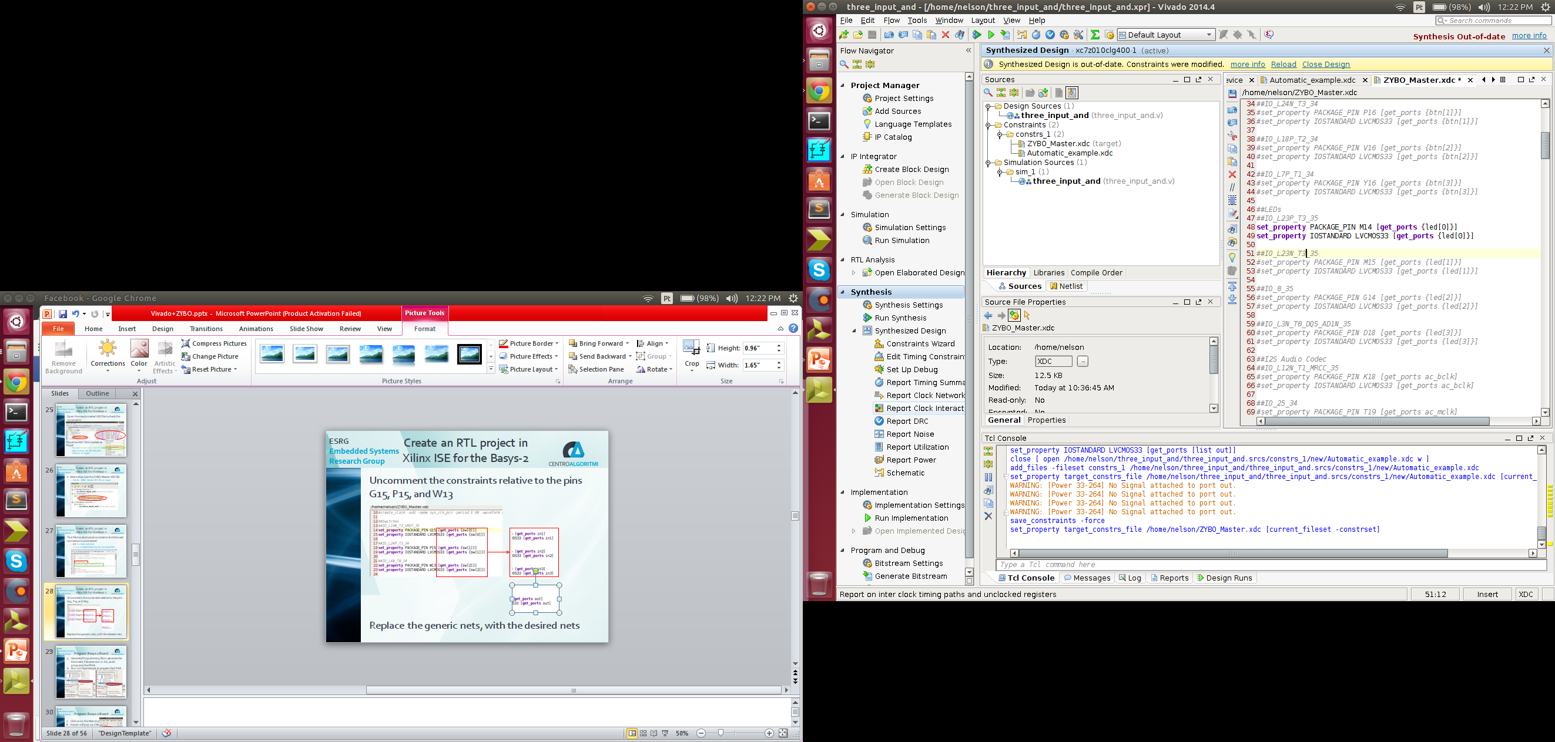
Program ZYBO PL
Uncomment the constraints relative to the pins G15, P15, and W13
Replace the generic nets, with the desired nets

Slide 30
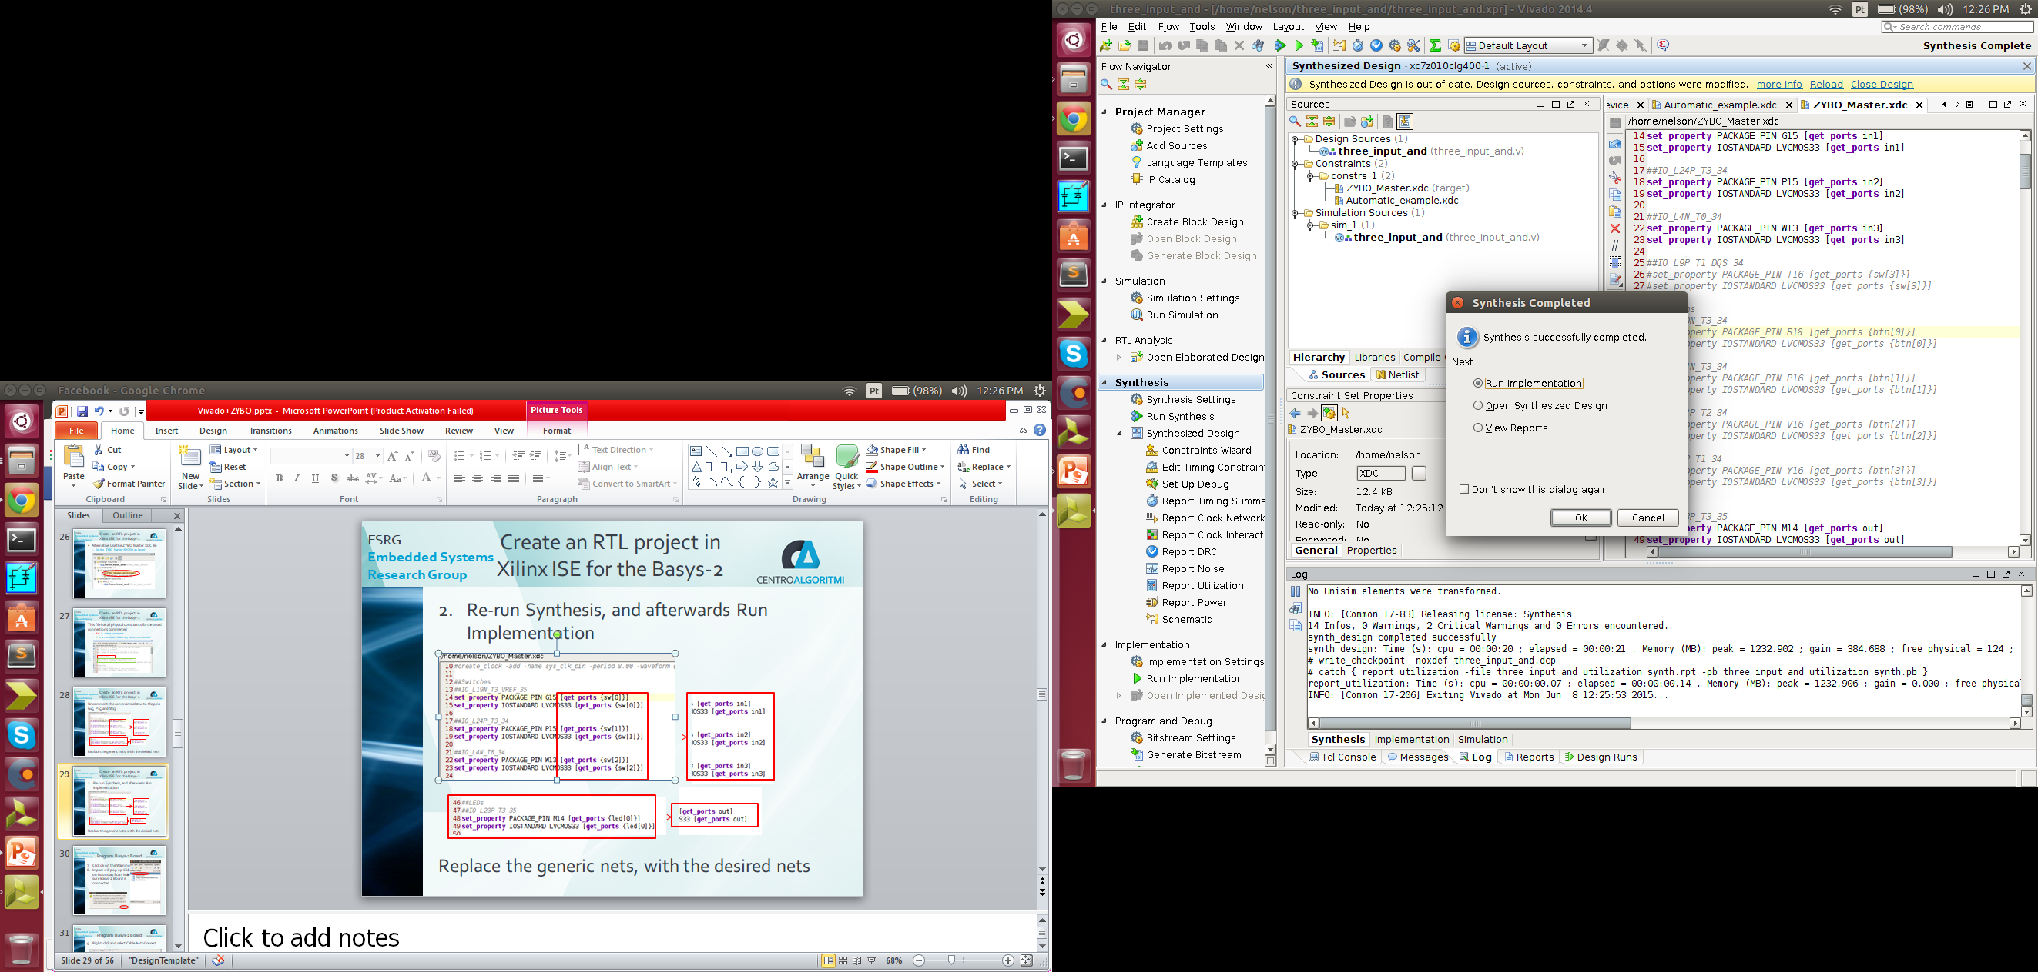
Create an RTL project in Xilinx ISE for the Basys-2
Re-run Synthesis, and afterwards Run Implementation
OR

Slide 31
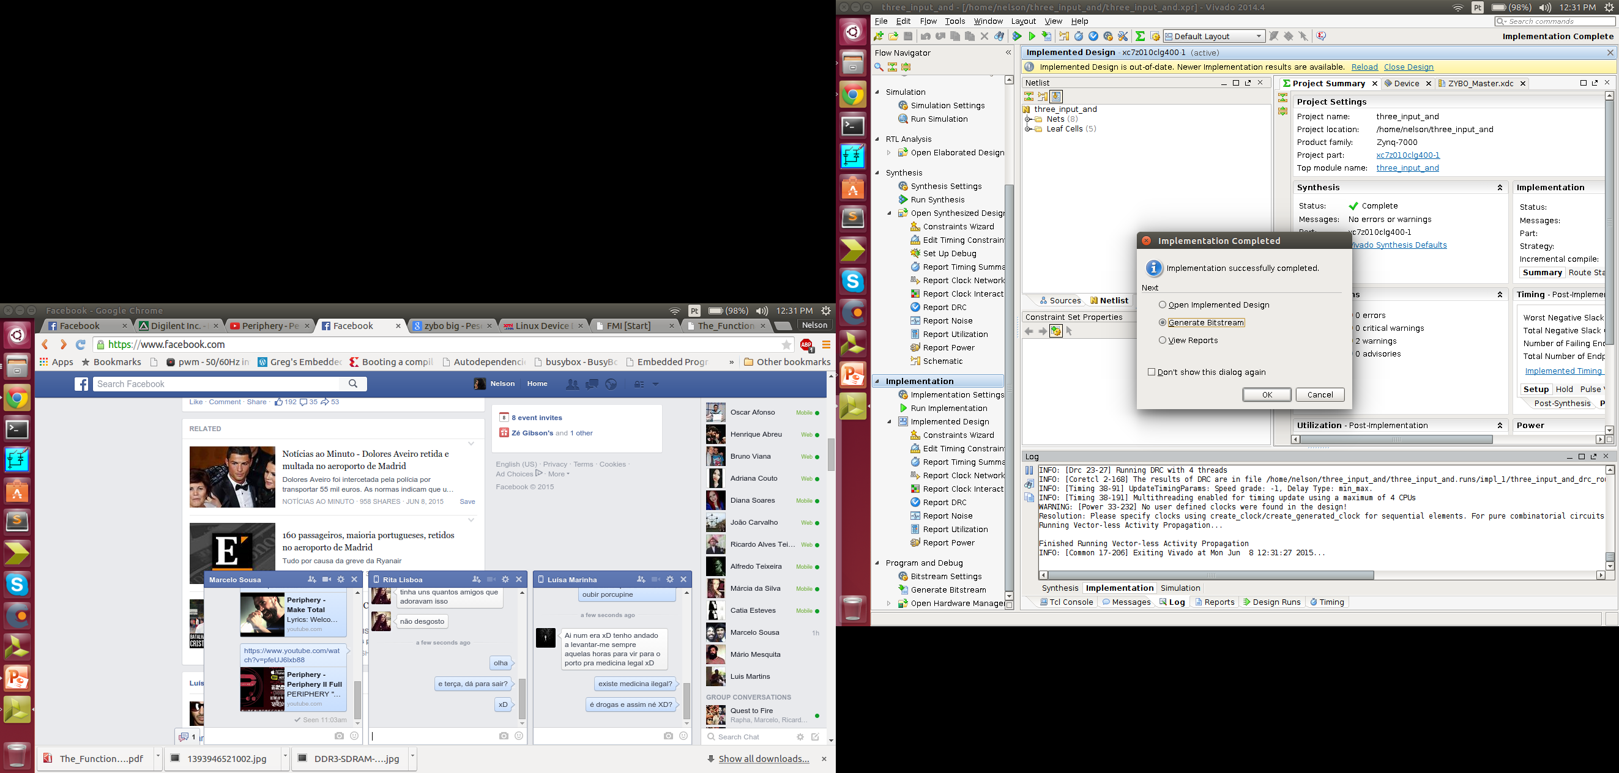
Program ZYBO PL
Generate Bitstream
OR

Slide 32
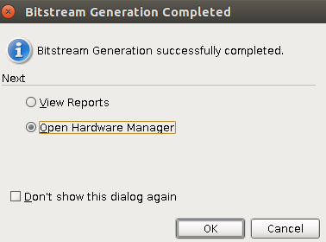
Program ZYBO PL
Open Hardware Manager
OR

Slide 33
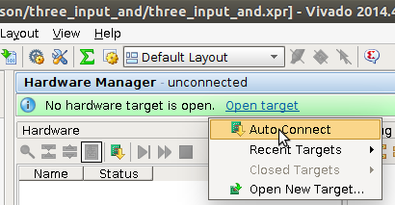
Program ZYBO PL
Click Open target->Auto-Connect with the board
Note: Make sure board power jumper is set to power on from USB and that the power switch is on

Slide 34
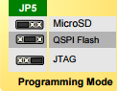
Program ZYBO PL
Programming mode
Note: Also, the JP5 jumper should be set to JTAG programming mode

Slide 35
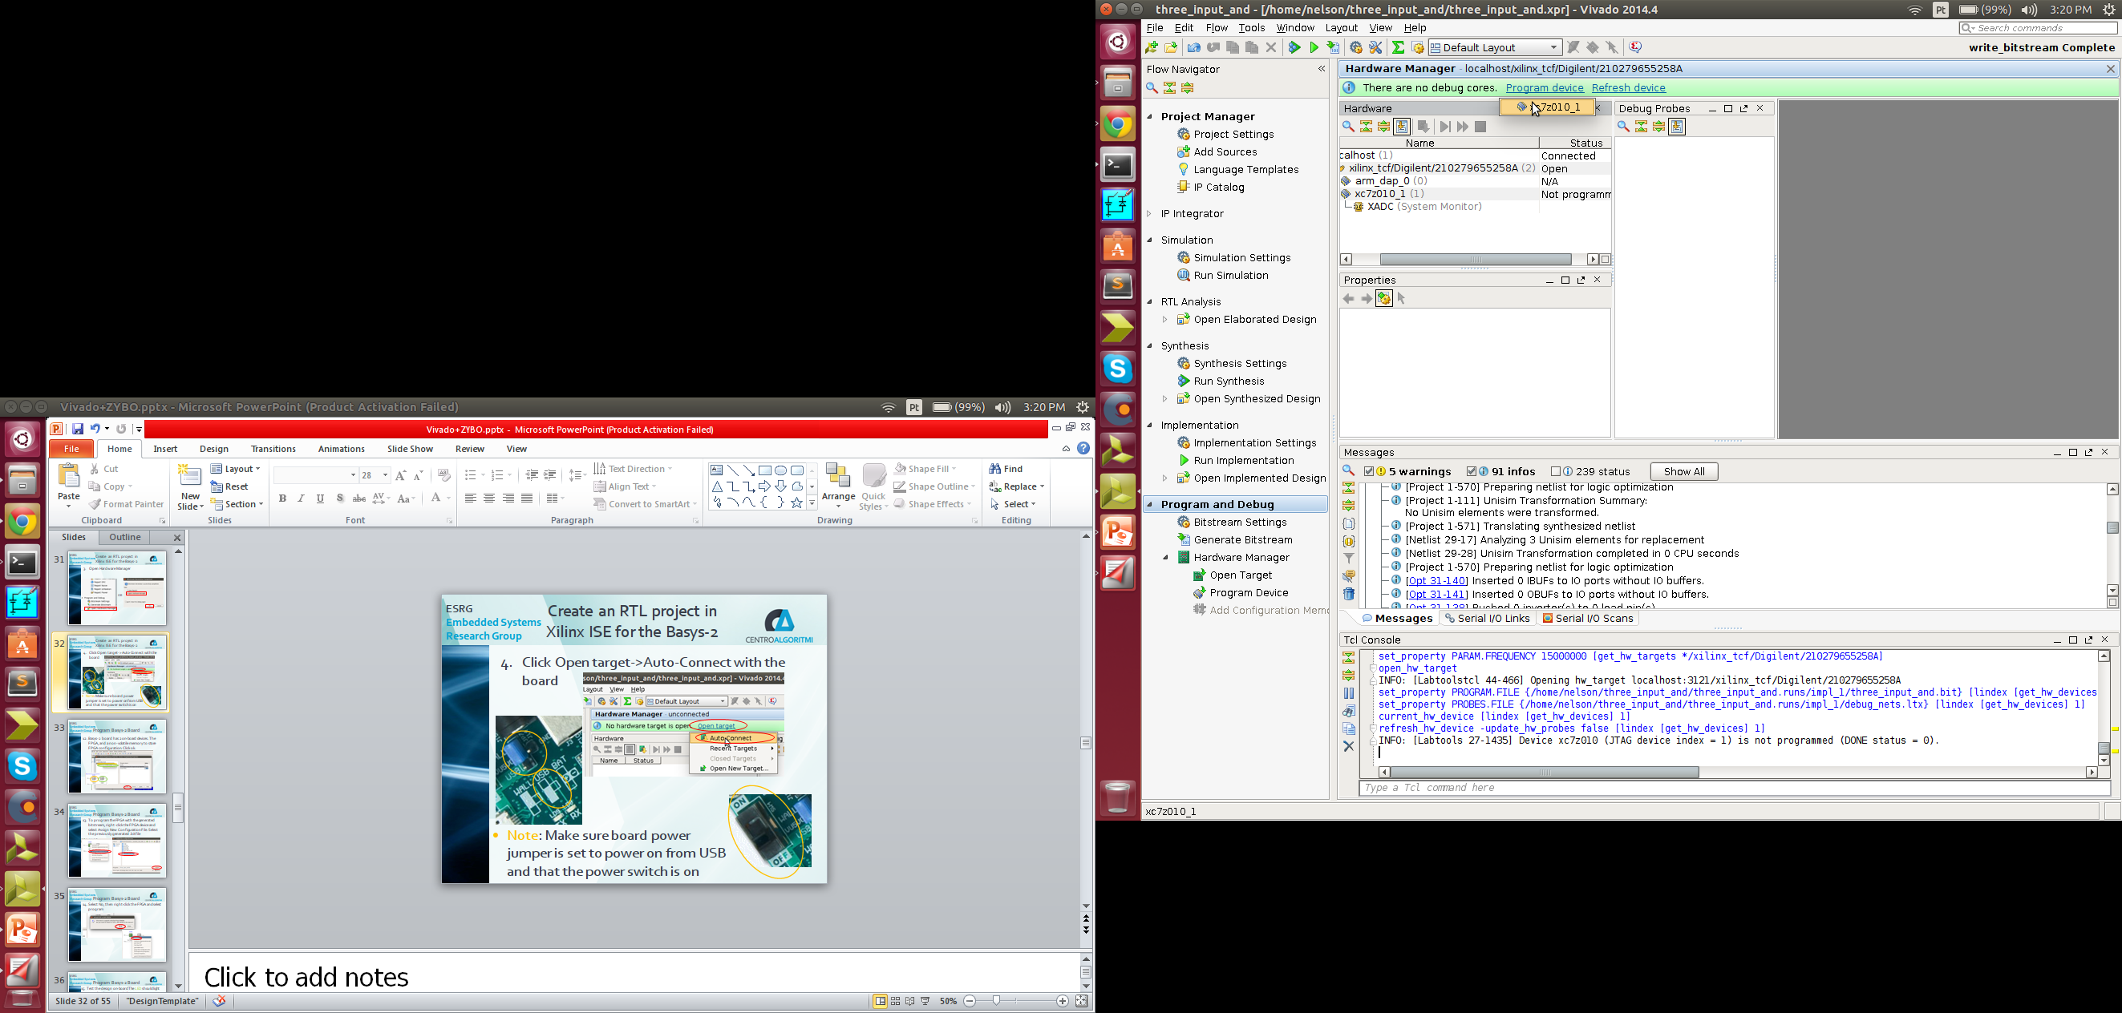
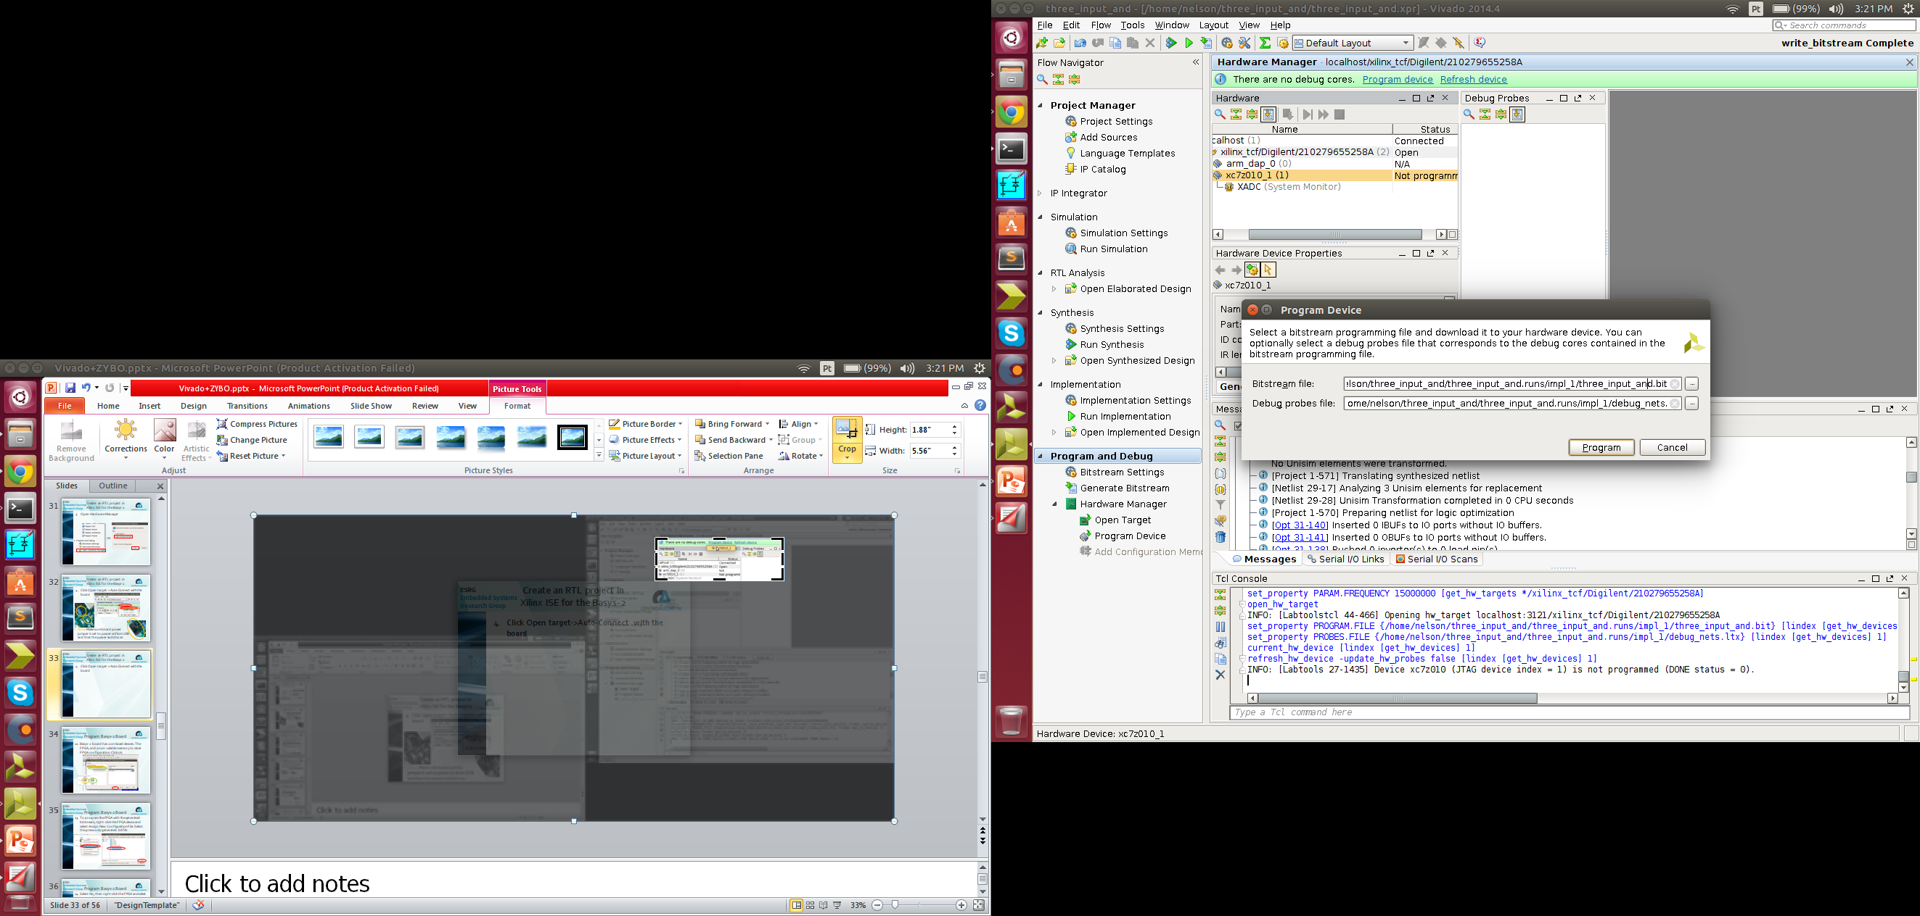
Program ZYBO PL
Program the device, and click ok for the default bitstream

Slide 36
Program ZYBO PL
When the programming is done, the DONE LED is going to be lit up
Test the design on-board The LED should light up only when the 3 switches are up

Slide 37
Instantiate an IP-core

Slide 38
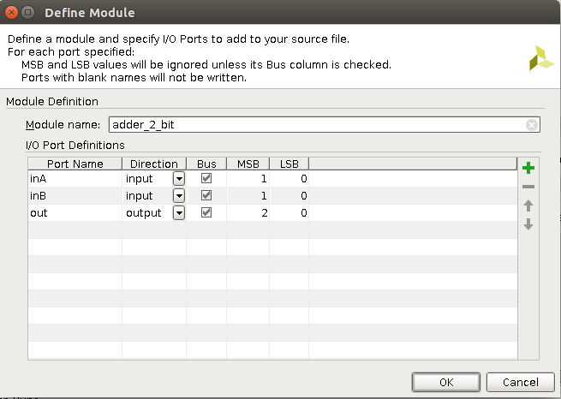
Instantiate an IP-core
Create a new project, with the following .v top level source file

Slide 39
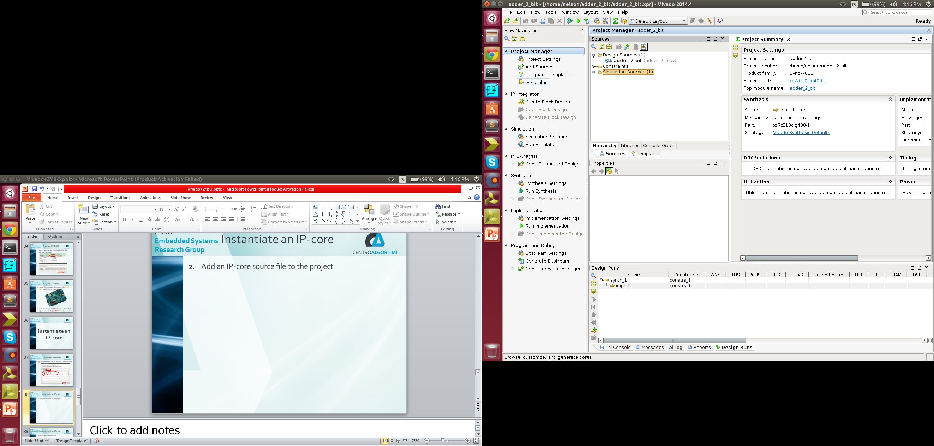
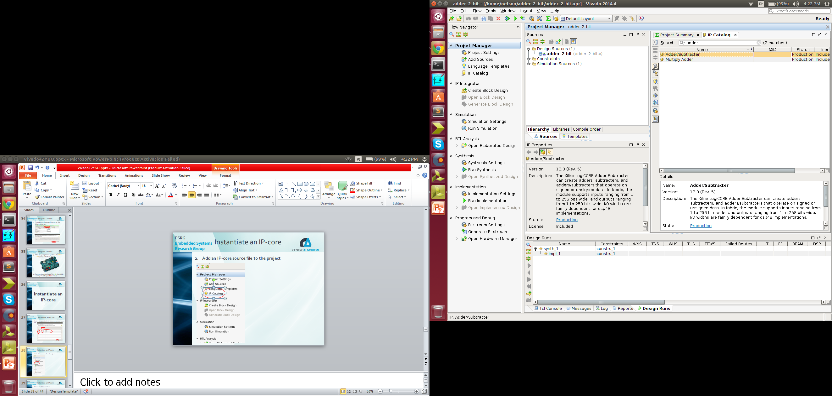
Instantiate an IP-core
Add an adder/subtracter IP-core file to the project

Slide 40
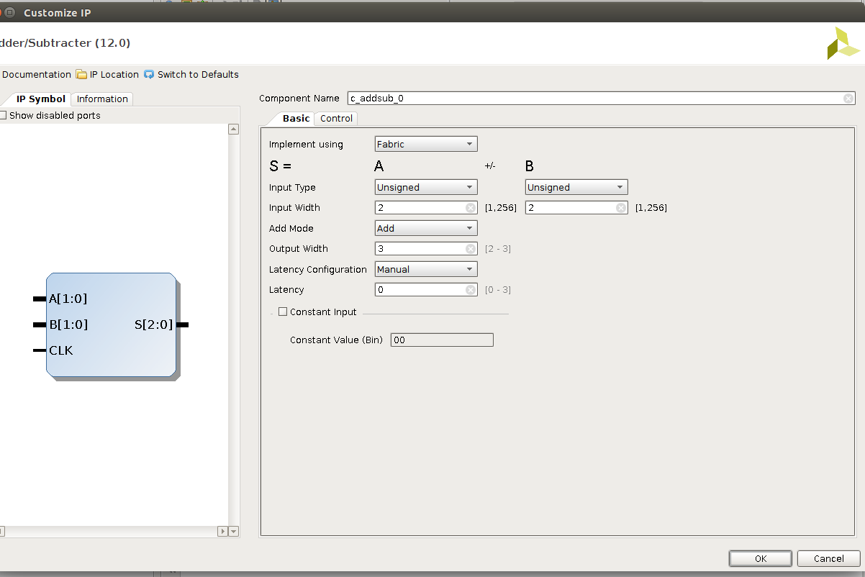
Instantiate an IP-core
Select unsigned 2 bit combinational adder(0 Latency)

Slide 41
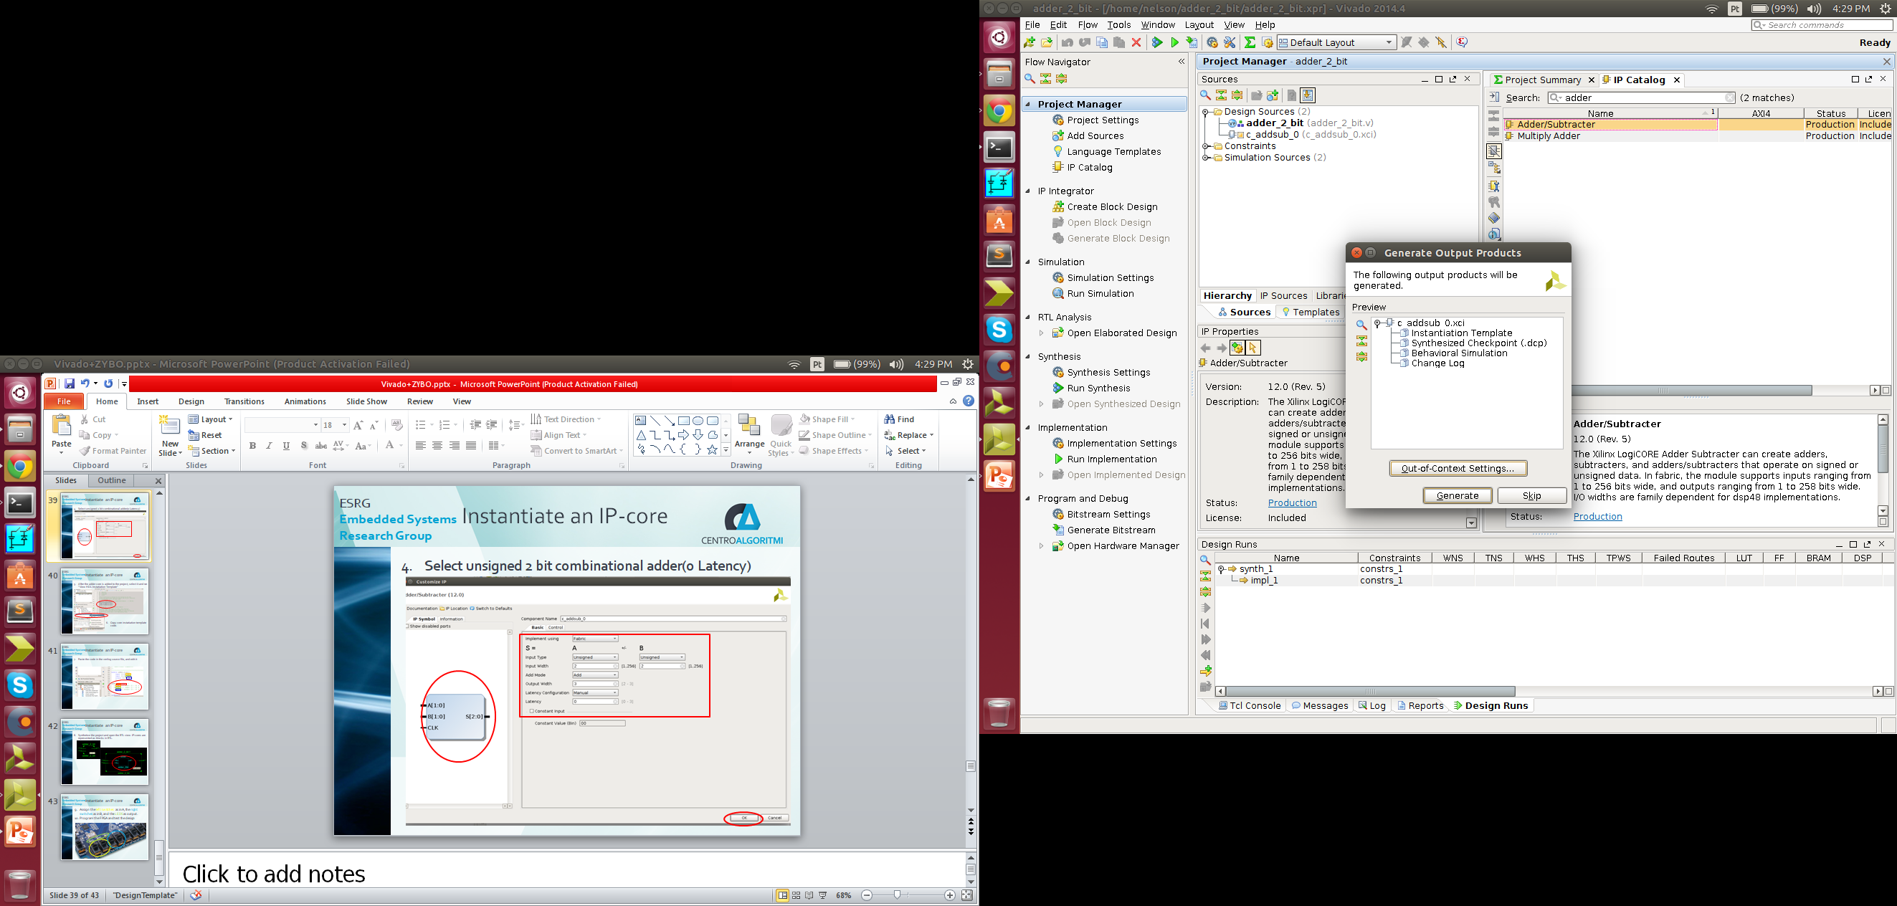
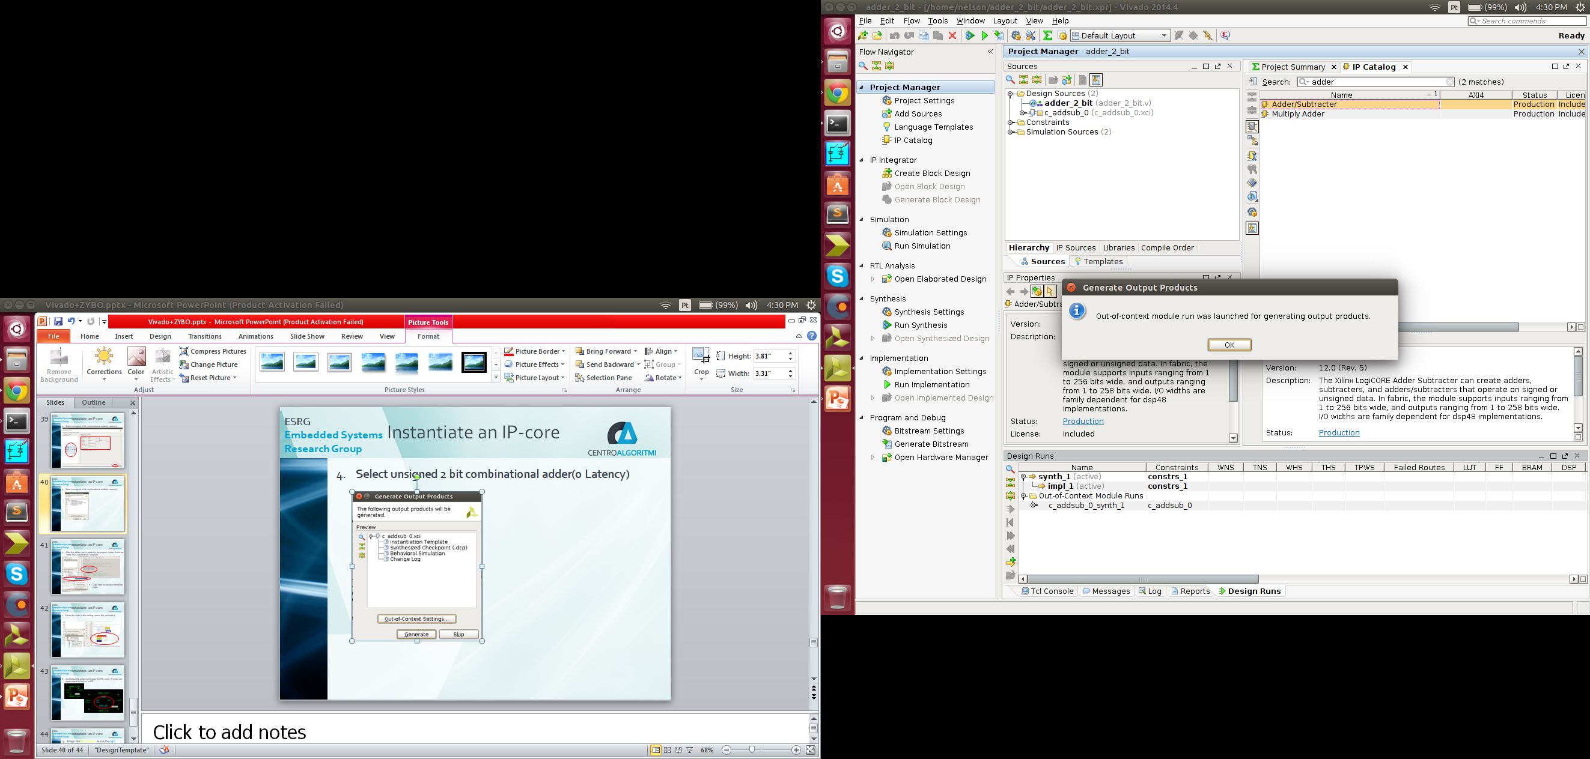
Instantiate an IP-core
Click generate, and then ok

Slide 42
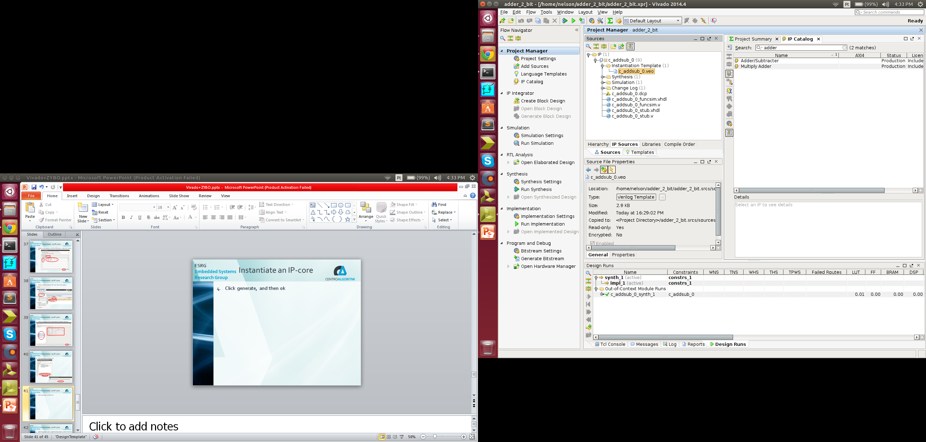
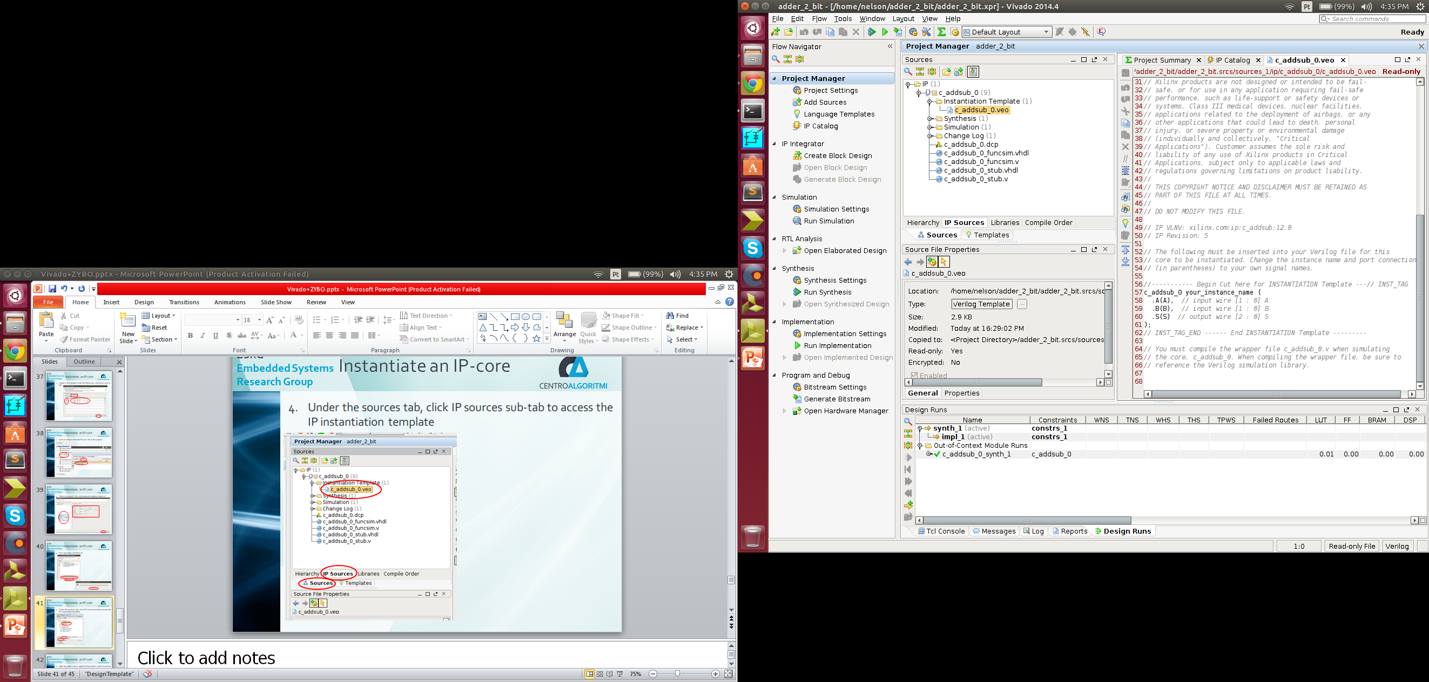
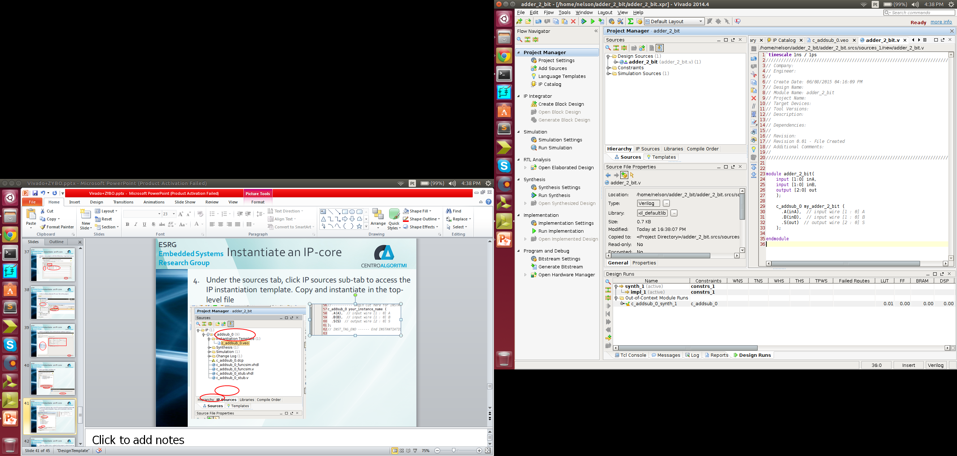
Instantiate an IP-core
Under the sources tab, click IP sources sub-tab to access the IP instantiation template. Copy and instantiate in the top-level file

Slide 43
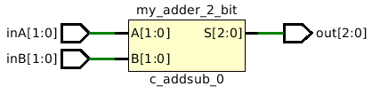
Instantiate an IP-core
Open elaborated design schematic
IP-cores are represent as square-blocks

Slide 44
Instantiate an IP-core
Assign the left switches as inA, the right switches as inB, and the LEDS as output.
Program the FPGA and test the design

